Slide 1
Dynamic Shock Modeling
Darren Barlow
Regional Technical Manager Perforating

Slide 2
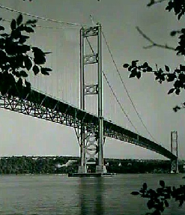
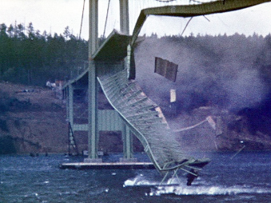
Leon Moisseiff
What if he had the ability to model?
What does it cost if you have a major failure on a well?
Disaster is intriguing if it’s not you!

Slide 3
Key Areas
Fineartamerica.com
Workplusplace.com

Slide 4
Large Guns

Slide 5
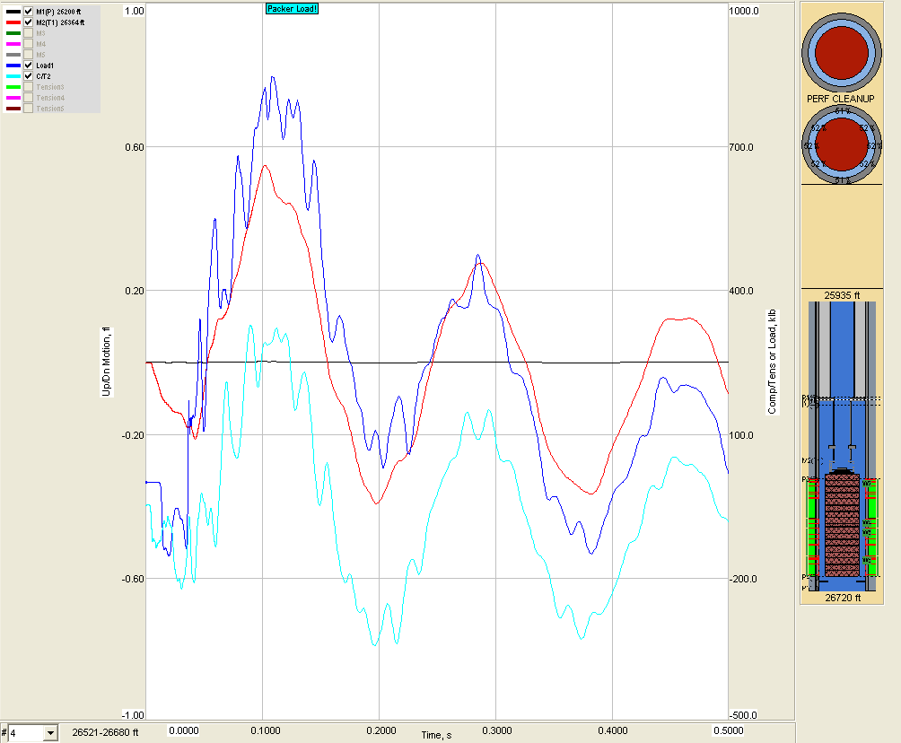
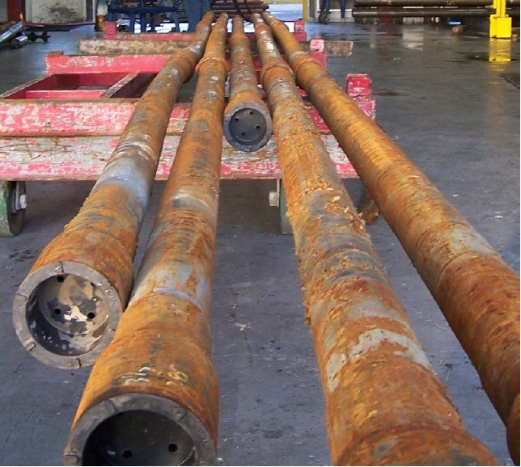
Modeling versus Reality
275’ of 6 ½ guns
Reservoir 15K
1.00
1000
830,000 lbf
Red – Tubing Movement
Blue – Packer Load
Cyan - Tubing Load C/T
-1.00
-500

Slide 6
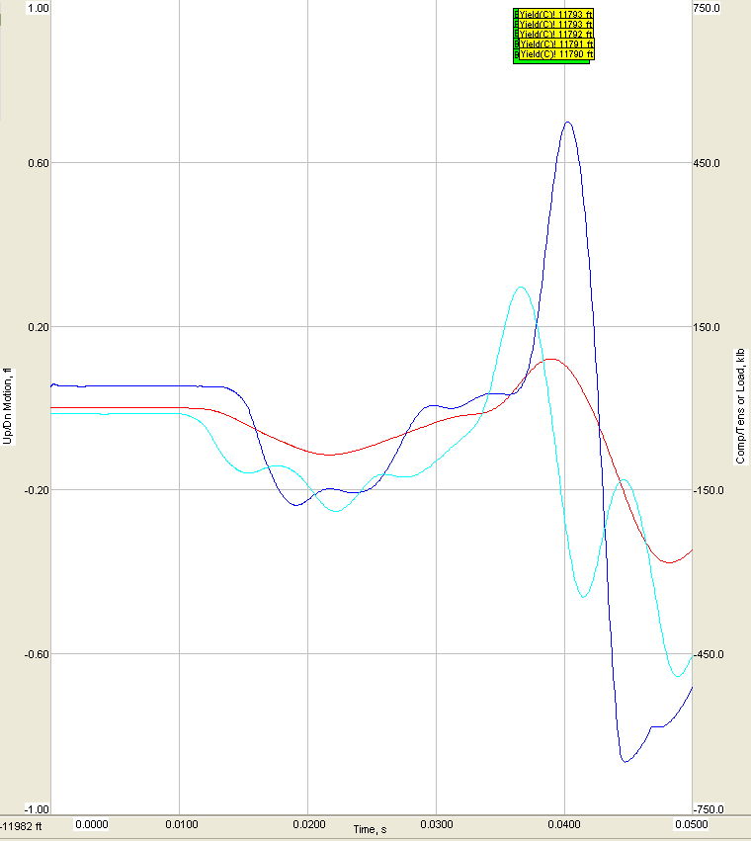
Avoiding NPT
Packer
10m 3 ½ 12.95 ppf
Release
10m 3 ½ 12.95 ppf
Ported Sub
Firing Head
60m 7” UHSD

Slide 7
Pressures Equals Loading
Red – Tubing Movement
Blue – Packer Load
Cyan - Tubing Load C/T

Slide 8
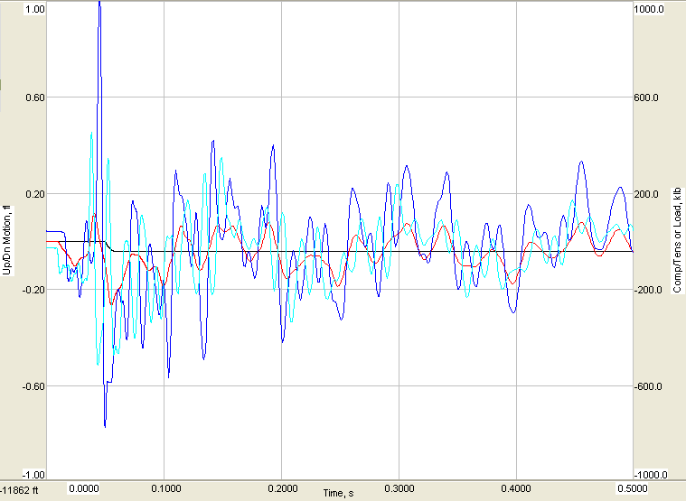
Strengthening the BHA
Packer
10m 5 ½ Drillpipe
10m 3 ½ 12.95 ppf
Release
10m 5 ½ Drillpipe
10m 3 ½ 12.95 ppf
Ported Sub
Firing Head
60m 7” 18 spf UHSD

Slide 9
Confined Spaces

Slide 10
Loss of well
Running Tool
Isolation Packer
Isolation plug

Slide 11
Movement
CWOP – 5’ Depth of the well was 25,000+

Slide 12
Bridge Plug- Well Integrity
*
Retrievable Packer
40
Packer
32
10m
Bridge Plug
24
16
36m 7” Guns
8
62m
*
Bridge Plug

Slide 13
Unknowns

Slide 14
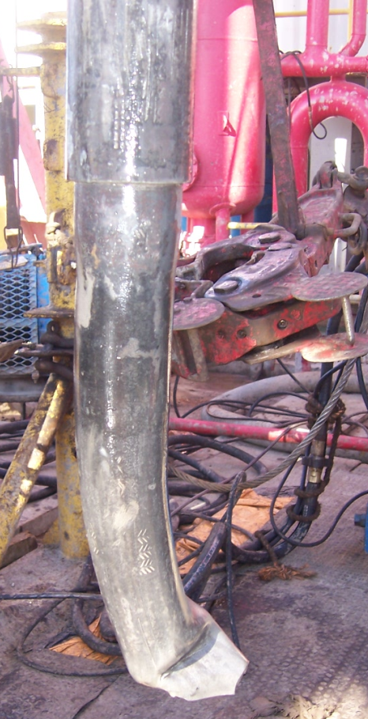
Component Failure
Formation test string
Champ IV
Packer
Why was Failure NOT Predicted?
Pup Joint w/ Firing Heads
35m of guns

Slide 15
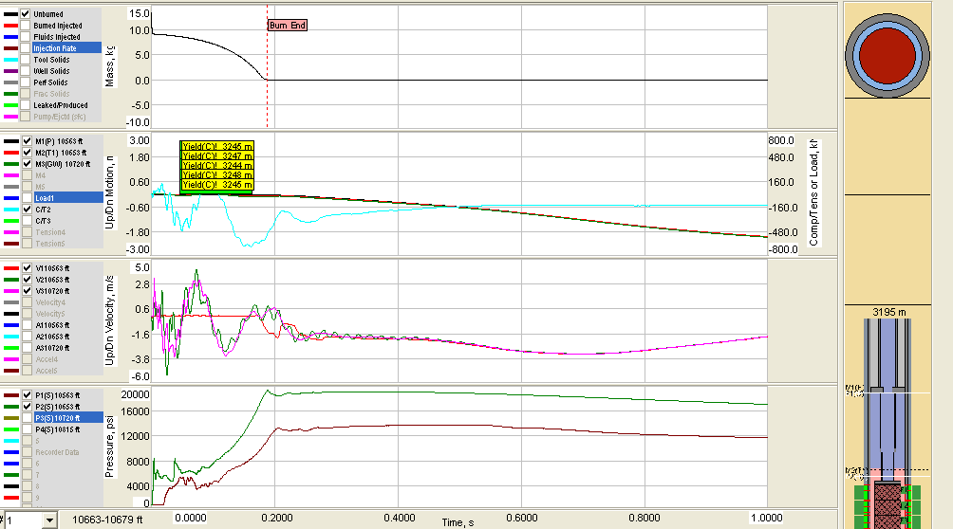
Post Failure Analysis
Gauge Analysis:
Reported k = 0.2 md
Actual k = 0.02 md
Changed perm and re-ran model
Predicted failure @ 3244m
Actual failure @ 3245m

Slide 16
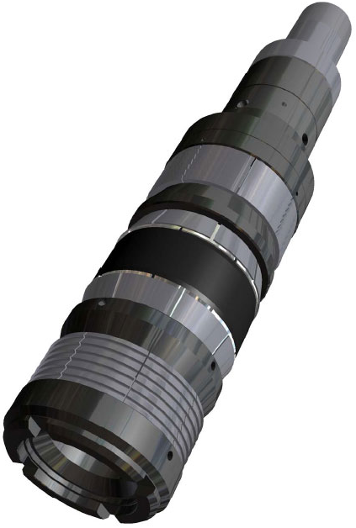
Summary
How can modeling help your completion challenges?
Darren Barlow
Regional Technical Manager- Perforating

