Slide 1
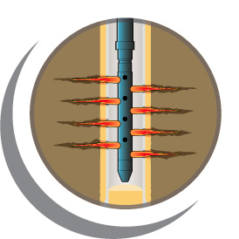
Perforating Requirements for Fracture Stimulation
Andy Martin, Larry Behrmann, Brenden Grove, Harvey Williams, Gerardo Arguello
Presented by:
Frank Thompson
Business Development Mgr North Europe

Slide 2
Agenda
Perforating objectives for fracture stimulation
Effect of perforating parameters
Horizontal wells
Conclusions

Slide 3
Perforating Objectives for Fracturing
Make frac jobs more effective
  Lower breakdown pressures
  Lower treatment pressures with better treatment rates
  Controlled frac placement
All of this leads to better production
Also helps avoid disasters like aborted jobs

Slide 4
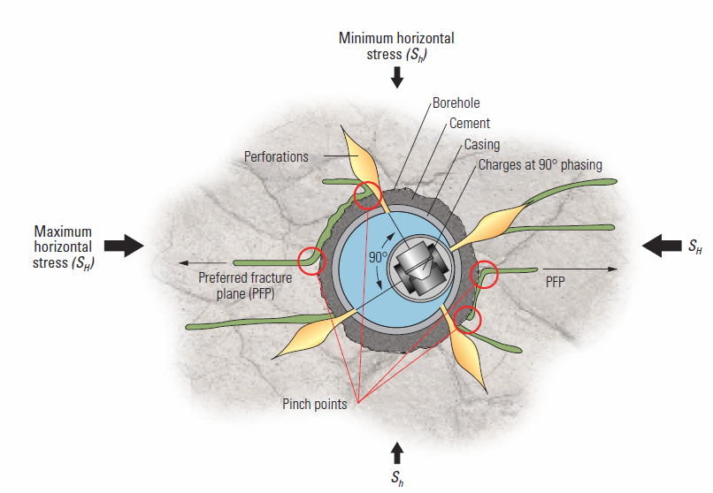
Perforating Objectives
Perforations should minimize:
  Near wellbore pressure drop
  Perforation friction
  Tortuosity
  Micro-annulus pinch points
  Multiple competing fractures

Slide 5
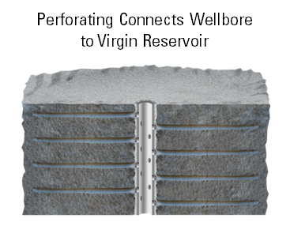
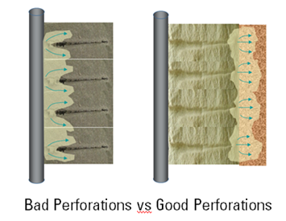
What can we control?
  Size and type of gun
  Penetration (type of charge)
  Casing entrance hole
  Shot density
  Shot phasing
  Interval length
  Gun orientation

Slide 6

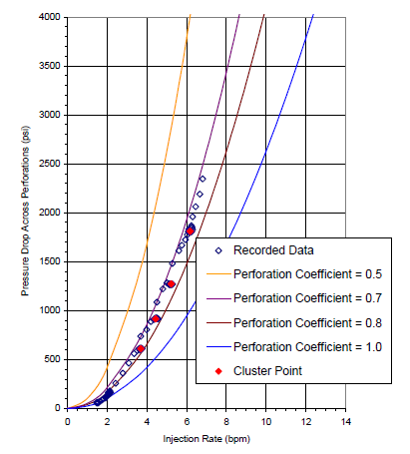
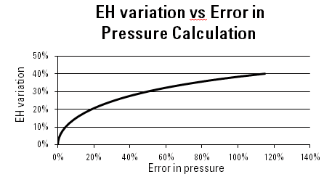
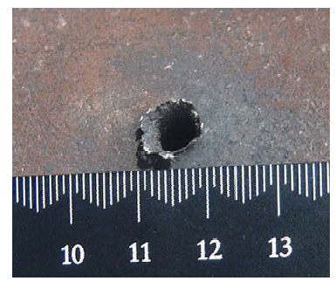
Casing Entrance Hole
EH size about 8 to 10 times proppant diameter to prevent bridging
Consistent EH for accurate limited entry designs
40% variation in EH results in 120% increase in pressure drop
EH variation
(from SPE 83590)
Error in pressure

Slide 7
Minimizing Casing Entrance Hole Variation
  Use largest gun possible to reduce water clearance
  Centralize gun
  Design shaped charge for minimum variation even across large water clearances
Best Frac Charge
Std
Frac charge
New Frac charge

Slide 8
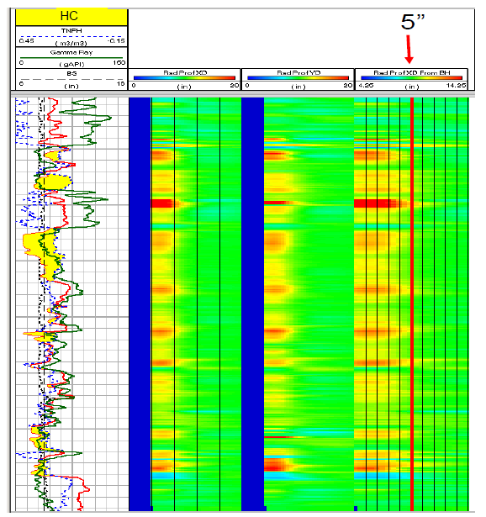
Is Penetration Important ?
Sometimes ignored (we just need some holes in the casing)
What about near wellbore conditions?
  breakouts
  formation damage?
  near wellbore stress?
Frac experts starting to realize that penetration is a benefit (>1 BH)
Connection to the far field helps avoid near-wellbore tortuosity effects
Up to 5-inch damage (SPE 112862)

Slide 9
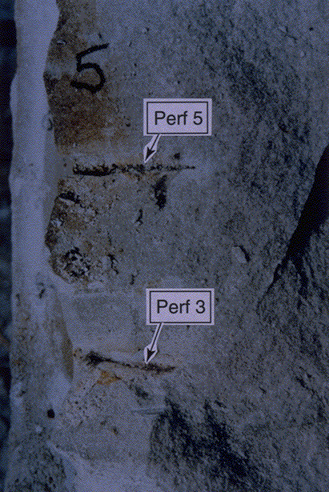
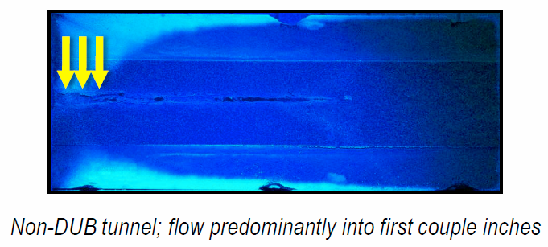
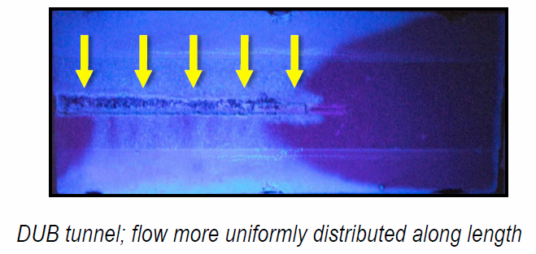
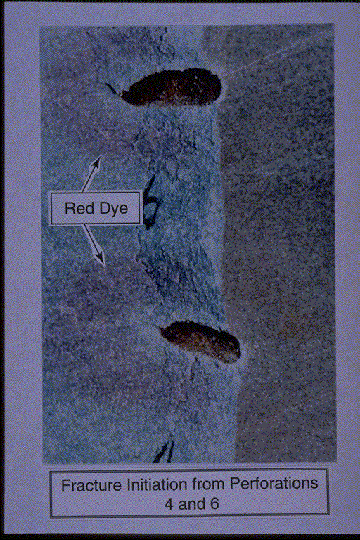
What about Clean Perforations?
Enable injection to start deeper in formation, avoids near wellbore damaged zone
Fractures may not initiate from plugged perforations (see “big block” tests left)
Clean perforations allow fluid leak-off, increasing near-wellbore pressure prior to fracture initiation
Plugged perforations NO fracture
(from SPE 143997)
Clean Perforations with fracture passing through perforations
(from SPE 20661)

Slide 10
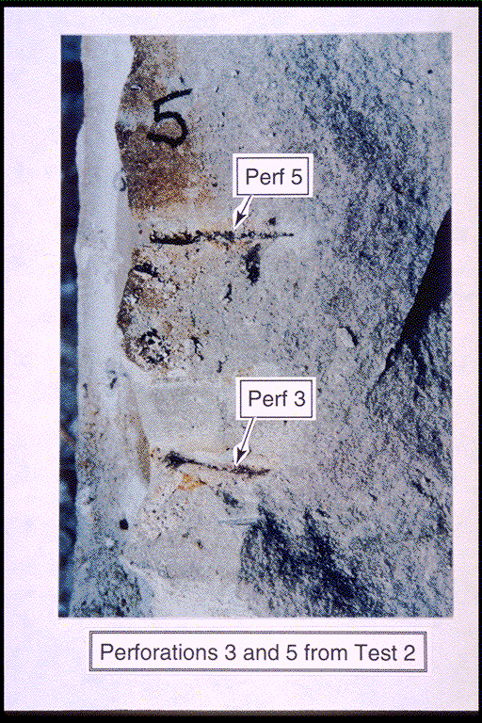
Plugged perfs → NO fracture
(from SPE 20661)

Slide 11
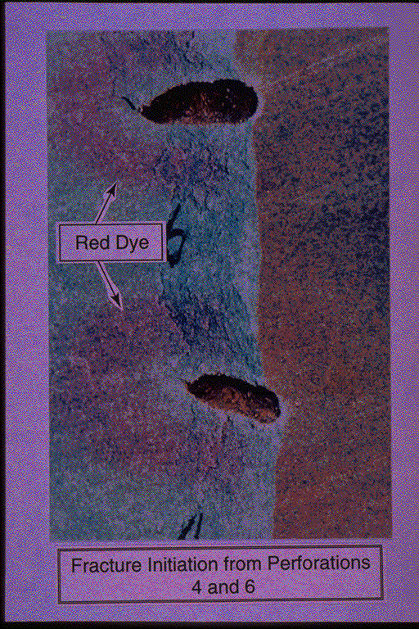
Clean Perfs → Fracture
(from SPE 20661)

Slide 12
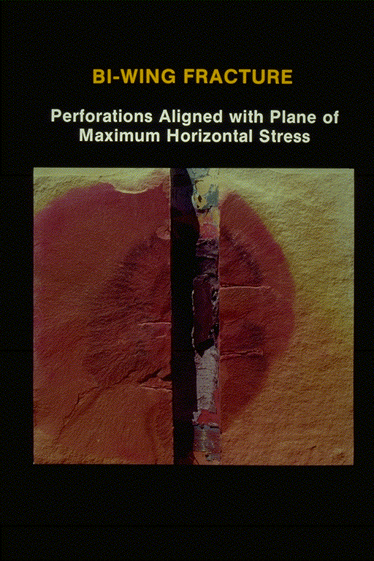
Gun Phasing and Direction
Near-vertical wells
Fractures initiate from perforations aligned with maximum stress direction
Best gun phasing is 0° – 180° in max stress direction
Perforations aligned with maximum horizontal stress
(from SPE 20661)

Slide 13
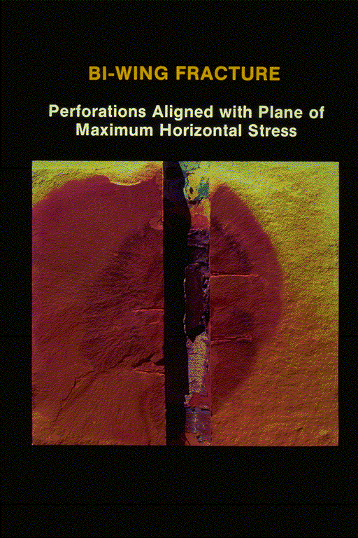
Perforations aligned with maximum horizontal stress
(from SPE 20661)

Slide 14
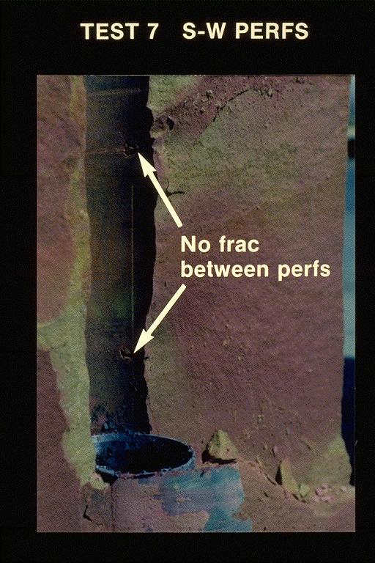
Gun Phasing and Direction
Near-vertical wells
Fractures initiate from sand-face when perforations are misaligned
Other gun phasings: 120° (at 1 ½ times spf); 60° (at 3 times spf)
Perforations misaligned with maximum horizontal stress
(from SPE 20661)

Slide 15
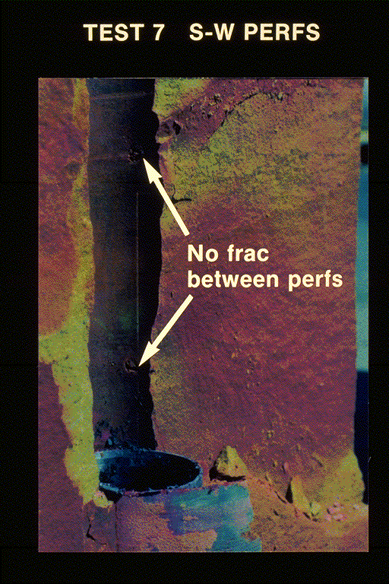
Perforations not aligned with maximum horizontal stress
(from SPE 20661)

Slide 16
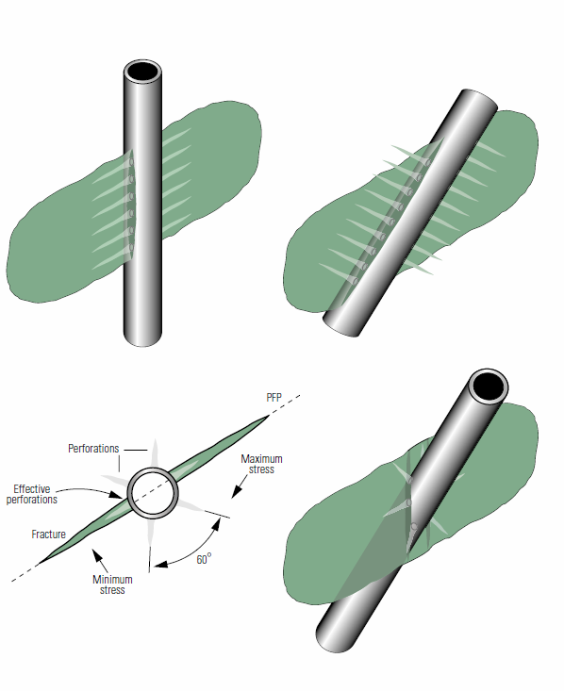
Well Direction and Gun Phasing
Gun phasing and interval perforated should be based on well direction compared to the preferred fracture plane

Slide 17
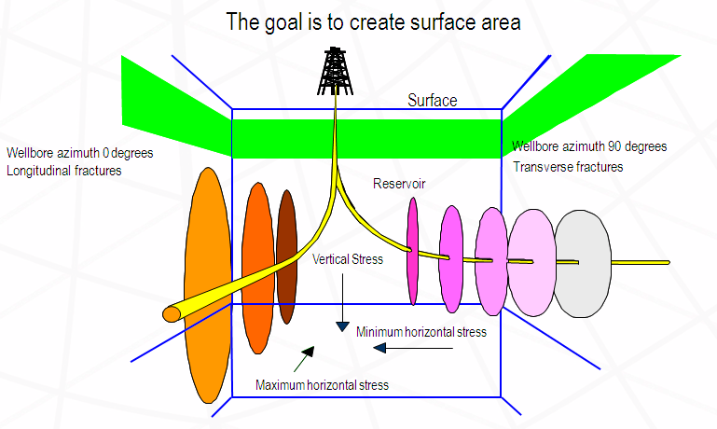
Hydraulic Fractures in Horizontal Wells
Longitudinal fracs
Transverse fracs
What we want

Slide 18
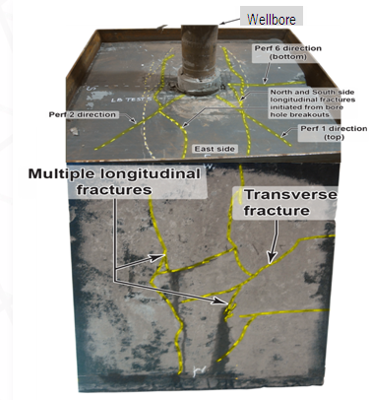
What We Get with 60° Phasing
Longitudinal fractures initiate first Terminate about 2 wellbore diameters in vertical direction
  Extend along wellbore
  Initial pumped volumes dominated by longitudinal fracs
Transverse fractures initiate after
  Perpendicular to longitudinal
  Do not rotate from longitudinal

Slide 19
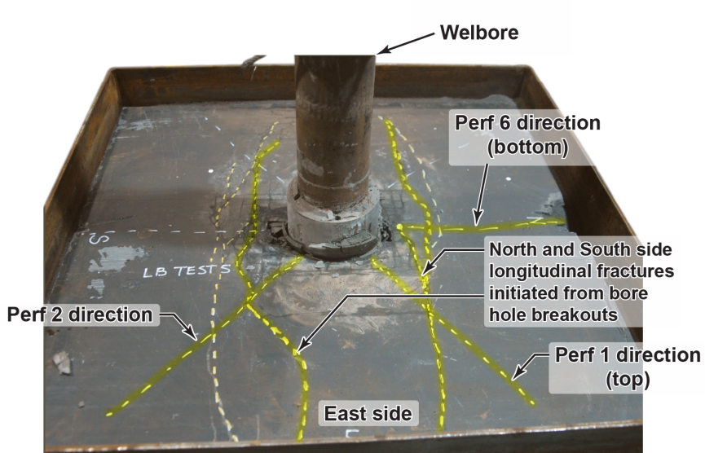
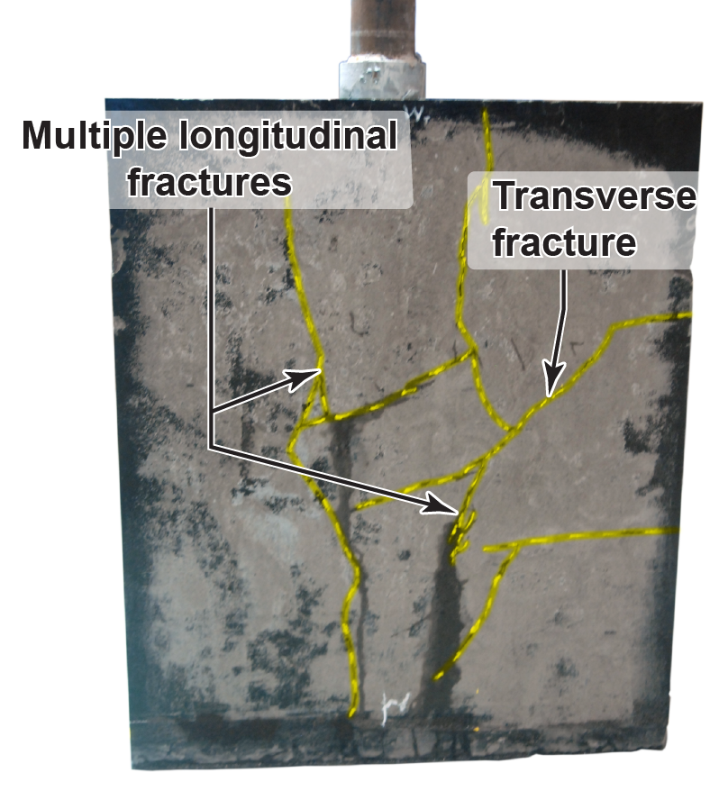
What we get
with
60° Phasing

Slide 20
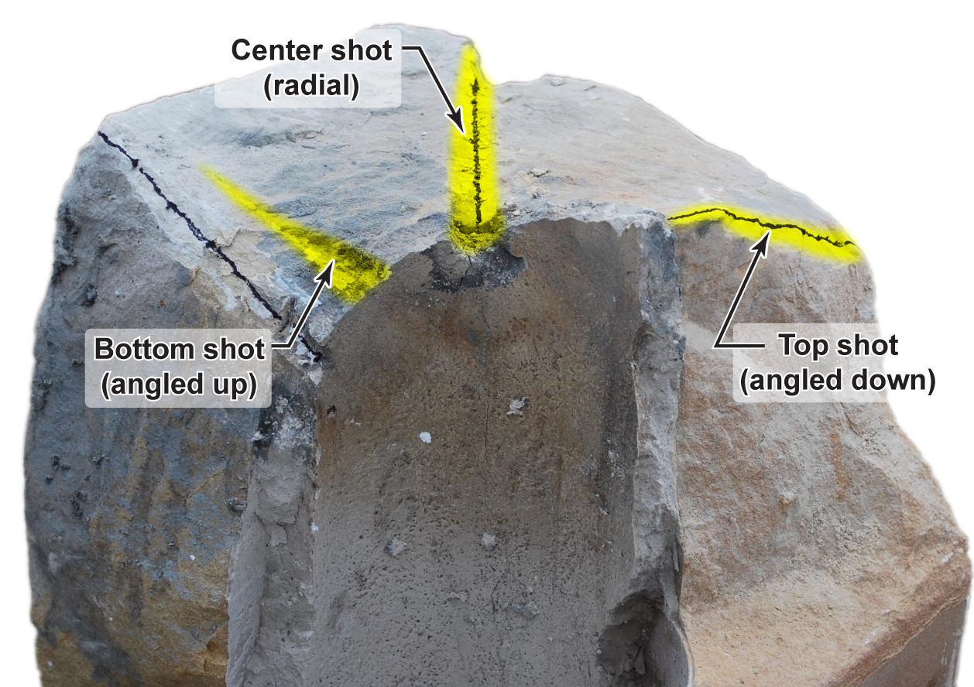
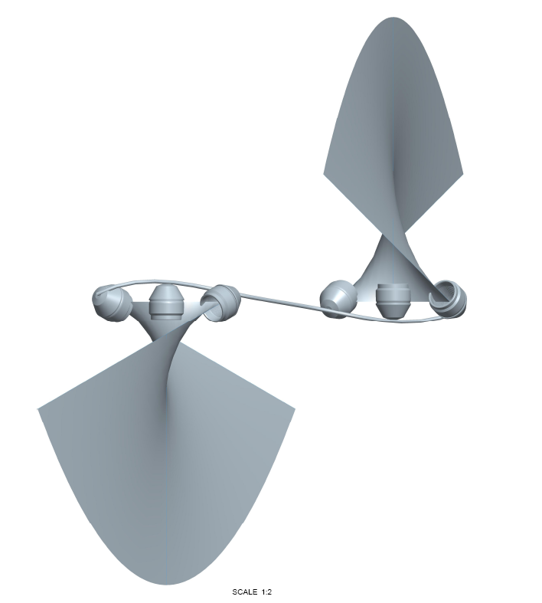
Can We Do Better?
Several experiments done in large blocks in a tri-axial stress frame to simulate horizontal well
Both DP and BH charges used
Directional perforations aimed at the same transverse plane
Transverse fracture from directed perforations
Result: Transverse fractures created

Slide 21
Directional perforations in the same transverse plane
→transverse fractures are created

Slide 22
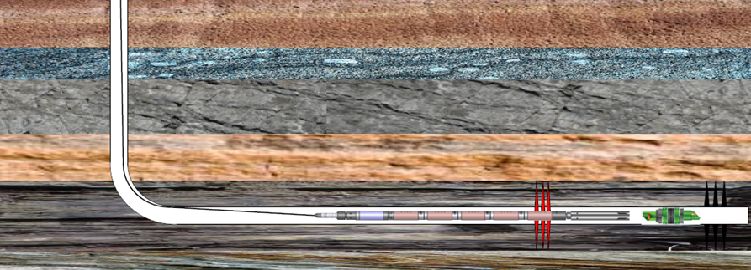
Perforation Gun Length-Horizontal Wells
In horizontal wells perforation length should be limited to
about 2 to 4 times the wellbore diameter (ref SPE 19720)
  Minimizes multiple competing fractures
Typical gun contains 6 to 10 shots (60° phased)
2 to 4 guns are shot for each frac stage
Guns run with addressable switches in pumpdown plug-n-perf mode

Slide 23
How Many Clusters per Stage?
Closely spaced clusters increases flow rate in gas shales
  Trade off is cost (number of fractures vs production)
  SPE 144326 shows study on production vs clusters for major shale plays
Reducing the number of clusters increases odds of all clusters being stimulated
  48% of perf clusters aren’t contributing in wells having 6 or more perf clusters / frac stage
Cluster placement should be matched to reservoir quality
  Requires detailed modeling
  SPE 146872 and SPE 146876 detail modeling work flow

Slide 24
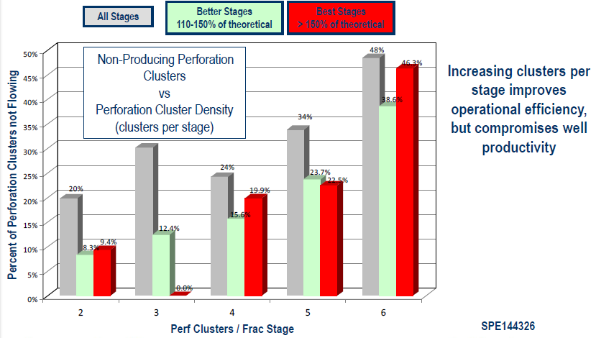
Horizontal shale well production log analysis

Slide 25
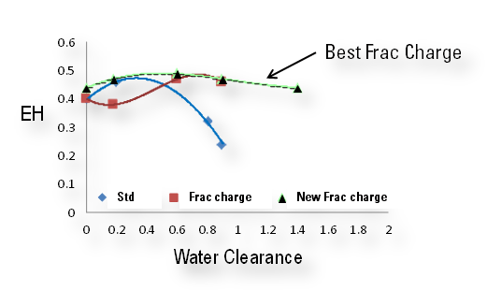
Conclusion
Well planned perforating will make frac jobs more effective
Careful choice of shaped charges, gun phasing and orientation will help initiate fractures and minimize tortuosity
In horizontal wells selection of number of shots, position of clusters impacts well productivity

Slide 26
Questions?

