Slide 1
Accurate Shock-capturing, Three-phase
Wellbore Flow Simulator with PVT Models for High-pressure, High-temperature Environment
IPS – 15 - 13
Minsuk Ji, Derek Bale, Rajani Satti
International Perforating Symposium
May 19-21, 2015, Amsterdam

Slide 2
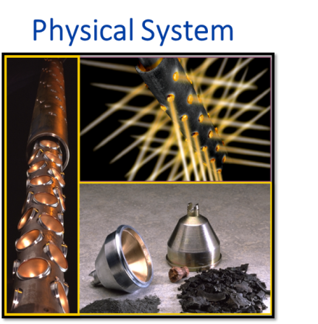
Presentation Overview
IPS – 15 - 13
Introduction
  What is driving our effort?
Requirements for modeling and simulation at practical runtimes
  Some challenges
Current computational platform
  Background
  Description
New multiphase wellbore flow simulator
  PVT models for high-pressure and high-temperature
  Accurate shock-capturing numerics
  Shock physics examples
Summary
Notes:
Current computational platform is PulsFrac.

Slide 3
Introduction – what is driving our effort?
IPS – 15 - 13
Modeling and simulation of dynamic downhole events during perforation operations are important for:
Post-Job Analysis
Experiment
Sensitivity Analysis
Risk Mitigation
Pre-Job Design
Pre-job design work flows that
Quantitatively evaluate options that optimize well completions
Mitigate risk of damage to completion/production equipment due to shock loading
Post-job analysis that
effectively integrates knowledge gained from field data back into the design work flow
Sensitivity analysis that
helps identify and understand dominant variables in flow laboratory experiments used to simulate components of the well-scale system

Slide 4
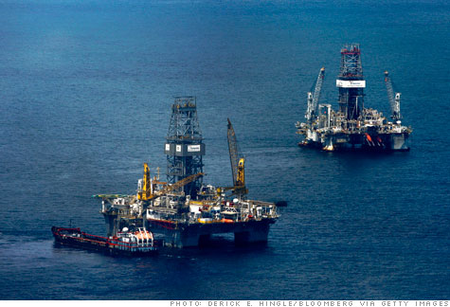
Introduction – what is driving our effort?
IPS – 15 - 13
In addition to continually improving job design work flows…
Next-Generation Well Completions
  High Pressure High Temperature
  Ultra-Deepwater
  Long Horizontals
  continue to drive an important need for validation & verification of both physical models and numerical algorithms.
Often, there is limited information available about the downhole conditions
  Tends to drive rather large DOEs for API-RP 19B Sections II & IV testing.
  Need for a validated lab-scale model to simulate flow dependence on relevant design parameters.

Slide 5
Modeling the downhole system – challenges
IPS – 15 - 13
Full system encompasses a non-linearly coupled wellbore – perf – reservoir with inherently different time- and space-scales
Flow equations governing evolution are multi-phase & multi-dimensional
HPHT thermo, shock, and gas burn physics
Robust Physical Models
Efficient Numerical Algorithms
Data Analysis & Interpretation
Predictive Modeling with Practical Runtimes
Solutions with strong gradients (e.g., pressure, velocity, density, etc.)
Small time scales with long working zones
Detonation/Deflagration waves
Complex tooling & perforation geometry
Must build cautious and constrained conclusions
Answer the right questions for risk analysis & mitigation
Field-scale interpretation through lab-scale modeling & experimentation
Notes:
Modeling a downhole perforation system is not trivial because of the following challenges:
Robust Physical Models
Efficient Numerical Algorithms
Data Analysis and Interpretation
With the right combination of these factors, one should be able to provide predictive models with practical runtimes. Resulting in quicker run times with higher accuracy outputs.
The basic philosophy of PulsFrac is that all models are based on physics, although some approximations are used to avoid the extreme complexities. However the overall philosophy of adhering to mathematical modeling is strictly adhered to throughout the code.

Slide 6
Current Computational Platform - Background
IPS – 15 - 13
Software platform for
computational modeling of transient, downhole perforating events.
Scientific platform capable of simulating short-time (0.5-tens of seconds) dynamic events in the coupled wellbore-perforation-fracture-reservoir system.
  Application space of perforation / stimulation jobs
  Power lies in the fact that each component (i.e., physical sub-model) is self-consistently coupled → no need for a priori assumptions on their relative importance
  Embodies our current physical knowledge of dynamical wellbore/reservoir system
  Flexible input for tooling and conveyance
Powerful Simulation Platform for Job Design and Analysis
  Power lies in entire down-hole system pre-job modelling
  Risk assessment and strategic mitigation,
  completion design and optimization,
  Performance prediction and Post-job analysis.

Slide 7
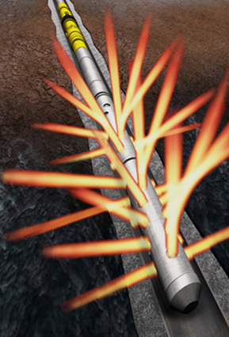
Current Computational Platform
IPS – 15 - 13
Dynamic Perforation Modeling
Solid Object Models
Fracture Generation & Propagation
Wellbore Flow Model
Perforation Flow & Cleanup
Reservoir Fluid Flow
Evolves partial differential equations for a compressible, non-equilibrium, multi-phase fluid mixture.
  Conservative finite differences
  Includes transient propellant burn
Dynamically tracks connection between wellbore and reservoir
  Includes shot density and phasing
  Dynamic clean up model
Fracture initiation and propagation
  Heat conduction, convection, radiation
  Debris flow in fracture
Guns, tubes, valves, other tools & metallic components
  Transient elastic behavior
  Tool failure models
Evolves multi-phase Darcy flow equations
  Constant temperature
  Layer-cake implementation
Notes:
PulsFrac utilizes a combination of complex and coupled physical models including wellbore flow, perforation flow, reservoir dynamics, tool models and fracture physics to model and simulate the dynamic perforating event.
All models are based on physics, although some approximations are used to avoid the extreme complexities of modeling this process on the micro-scale, but the overall philosophy of adhering to mathematical modeling using only reasonable physics-based phenomena is strictly adhered to throughout the code. The underlying finite-difference numerical scheme employs adaptive gridding and anti-diffusion flux for speed and accuracy.

Slide 8
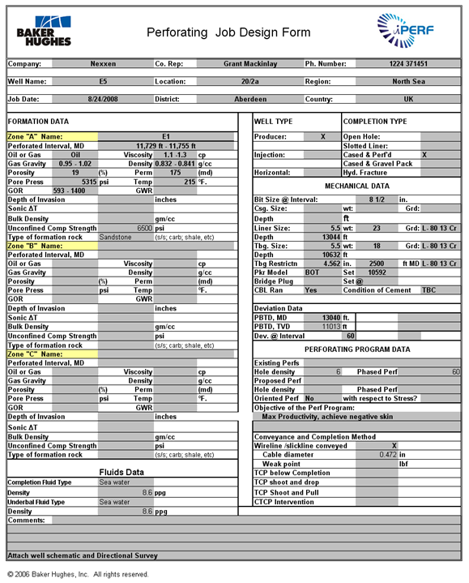
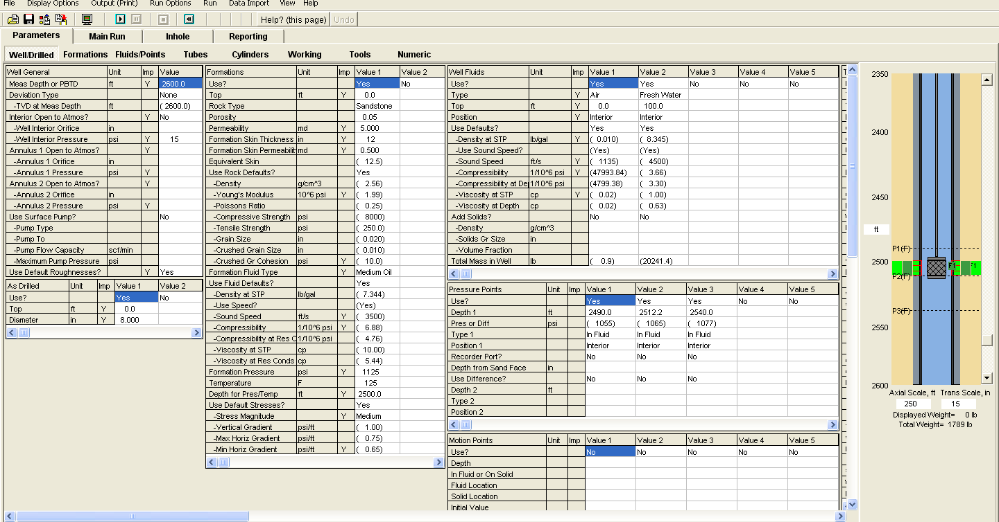
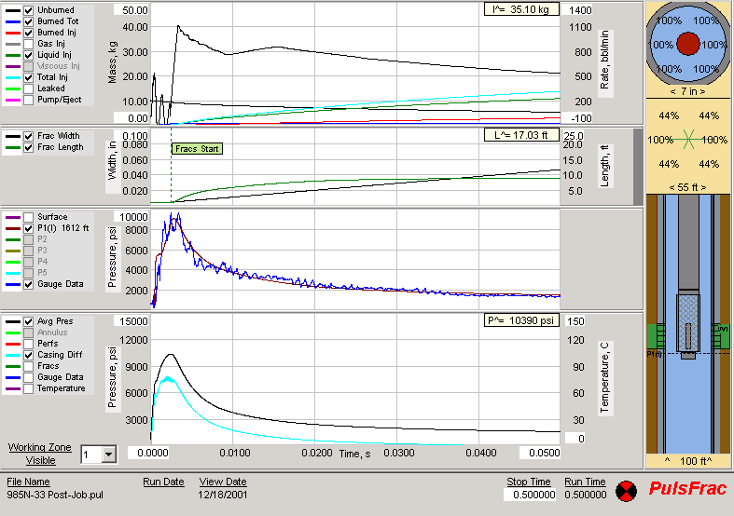
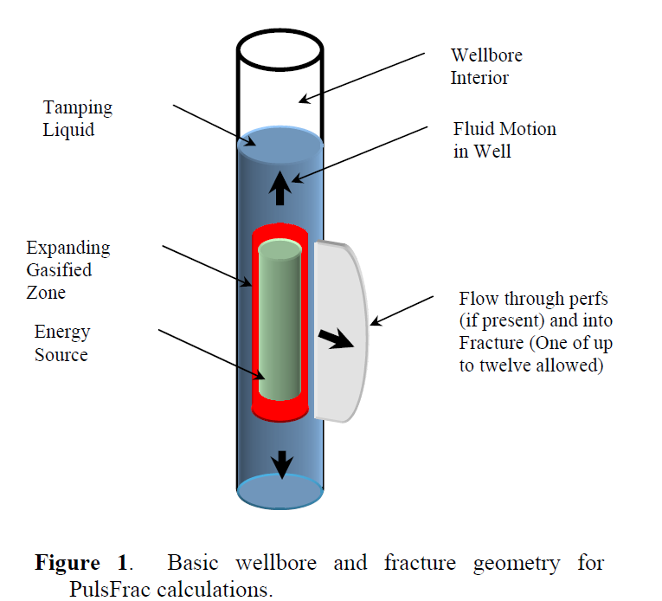
Typical Downhole Event Simulation
IPS – 15 - 13
User fills out a Perforating Job Design Form
Information gets entered in the Graphical User Interface by a knowledgeable user
Results are analyzed for pre-job completion design
Notes:
Identify goal or objective, fill out Perforating Request Form
Make an initial assessment
Identify any specific problem areas
Run a pre-job PulsFrac model
Identify possible risks
Prepare recommendation, possibly running more detailed PulsFrac models
Write a detailed report including job procedure
Execute the job
If high speed data is obtained, or there are any surprises, run post-job PulsFrac model.

Slide 9
New Multiphase Wellbore Simulator
IPS – 15 - 13
Current modeling platform has been successfully applied to a wide range of perforation jobs, but…
  Complex well completion scenarios continue to drive the need for more accurate, robust, and well tested physics-based models & numerical codes.
  A more thorough integration of job design modeling into workflows continues to drive the need for improved computational speed and efficiency.
Significant effort is currently being put into evaluating, improving, and testing our current simulation platform.
  Mathematical Flow Models
    Flow equations
    Thermodynamics
  Numerical Implementation
    Conservative schemes based on Riemann problems
Wellbore Model
Thermodynamics
Numerical Implementation
Mathematical Evolution Equations
Notes:
As part of our next-gen efforts, we are primarily focused on advanced mathematical flow models (revisiting and updating our flow equations/thermodynamics) and numerical implementation (Riemann problems)

Slide 10
Thermodynamics
Proper Closure for Accurate Time Stepping
IPS – 15 - 13
A typical time step for a flow solver requires:
  Three evolution equations
  An equation of state:
t^{n}
Apply Conservation of
Mass
Momentum
Energy
Mass
Velocity
Pressure
Temperature
Accuracy in the solution of the evolution equations can be destroyed by inaccurate thermodynamics.
t^{n+1}
Mass
Velocity
Temperature
Apply Equation of State
“Thermodynamics”
P=P(ρ,T)
t^{n+1}
Mass
Velocity
Pressure
Temperature
n++
Notes:
Theremodynamic equation of state is used to close the system of governing equations. This is for single phase flow solver. We have 4 unknowns (mass, velocity, pressure and temperature), but have only 3 equations (mass, momentum and energy). Thermodynamic equation of state is used to properly “close” the set of equations and obtain pressure. Note that multiphase flow solver is more complicated because we have more unknowns, but similar concept still applies.
At time step t_n, all quantities are known. In order to obtain solutions at the next time step t_n+1, we first solve conservation equations for mass, momentum and energy. By solving these equations, we obtain mass, velocity and temperature at time step t_n+1. At this point, we still do not know pressure at time step t_n+1. This is where thermodynamic equation of state comes in – thus closes the set of equations. Equation of state relates pressure to density and temperature, both of which are known at time step t_n+1. Once pressure at t_n+1 is obtained via equation of state, we repeat the solution process for going from t_n+1 to t_n+2.
Accurate thermodynamics is particularly important for high pressure and high temperature environment. Inaccurate thermodynamic equation of state negatively affects all other quantities because all of them are tightly coupled through the solution process described above (the flow chart).

Slide 11

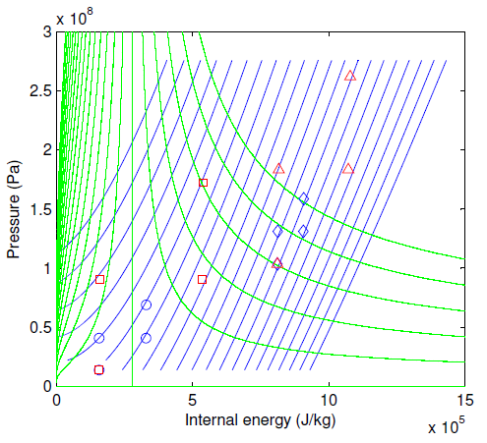
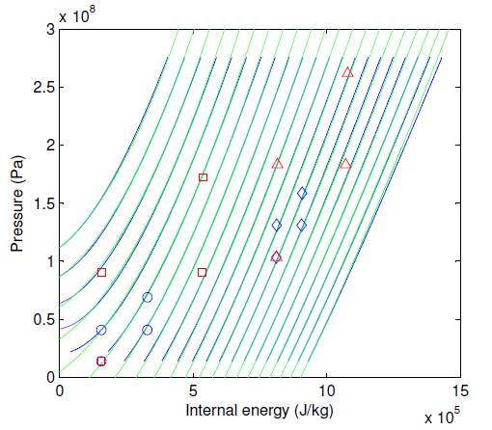
Thermodynamics – Improved Equation of State
IPS – 15 - 13
Constant density curves from NIST database are fit with a quadratic polynomial in the pressure-energy plane (Temperature up to 600 F, Pressure up to 40 kpsi). Coefficients are functions of density.
HPHT Region
NIST database (exact)
Model equation of state
LPLT weak shock test
LPLT Region
LPLT strong shock test
HPHT weak shock test
HPHT strong shock test
(see slide 14 for tests)
Current Software Thermo
New Thermo
Improved equation of state does a much better job of approximating HPHT region!
Notes:
The curves represent constant-density lines in the internal energy (which is related to temperature) and pressure plot; this is a graphical representation of equation of state. The fluid is water. Blue curves are from NIST database. Green curves are current software thermodynamic model (left plot) and new thermodynamic model (right plot). Symbols represent different thermodynamic states related to our shock test problems (slides 13 and 14); they show how wide the ranges of pressure and temperature that we are concerned with. Note that the ranges shown in these plots corresponds to pressure up to 40000 psi and temperature up to 600 degF.
It can be seen that in the left plot, the green and blue curves do not match, and behave in a significantly different way, while in the right plot, the green and blue curves match very well. New equation of state (right) does a much better job in representing the real (NIST) equation of state than that used by the current software (left). This is especially the case for high pressure, high temperature (or internal energy) region in the plot, or upper right hand region of the plot.

Slide 12
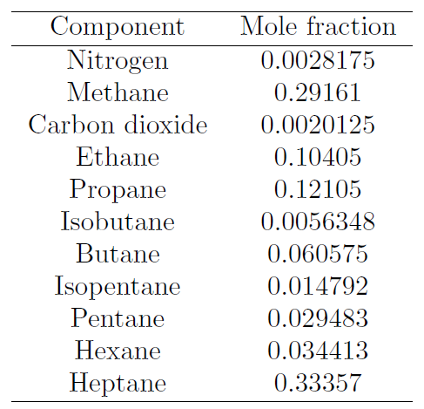
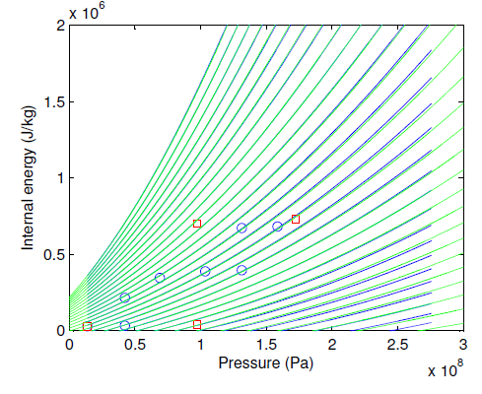
Thermodynamics – Improved Equation of State
IPS – 15 - 13
The low-order polynomials produce computationally efficient EOS calculations
A wide variety of liquids can be handled using this method
  data is pulled from NIST database
  coefficients are defined by performing the appropriate fits
Example: Oil composition
Methodology can be applied to many different liquids, including ones with complex compositions
Notes:
Plot in this slide follows almost identical explanation as that in the previous slide (slide 11).
The point of this slide is:
Our approach of improving equation of state can be applied to different compressible liquids, including oil composed of many components, which is shown in the left table.

Slide 13





Idealized Computational Test Cases in Perforating
IPS – 15 - 13
Parameter | Value | Units
Gun Length | 10 | ft
Casing ID | 8 | in
Shot Phasing | 6 | ft⁻¹
Expl. Mass per charge | 40 | g
Expl. Molar Weight | 222 | g/mol
Expl. Heat of Explosion | 83 | kJ/mol
P₋
$${∆P=P}_{+}−P_{−}$$
$=α (γ−1)\frac{∆E}{V}$
Total heat of explosion:
P₊
$$∆E \sim 906 kJ$$
α: fraction of energy that increases fluid internal energy
γ : fluid ratio of specific heats
$$V$$
$$z$$
From relevant completion parameters, energy released by gun-firing can be approximated. This also gives increased pressure in the wellbore. They are used as initial condition for flow solver.
Notes:
P- is the pressure before the gun firing. The energy released by the gun firing increases the internal energy as well as the pressure of the wellbore fluid. These P- and P+ provide the initial state for simulation of shock test problem.

Slide 14

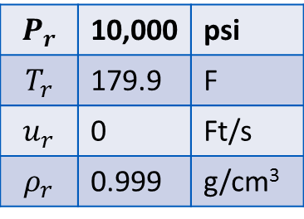
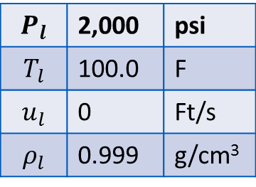

Test Cases – Four Examples
IPS – 15 - 13
$$P_{l}$$ | 2,000 | psi
$$T_{l}$$ | 100.0 | F
$$u_{l}$$ | 0 | Ft/s
$$ρ_{l}$$ | 0.999 | g/cm³
downhole
$$P_{r}$$ | 10,000 | psi
$$T_{r}$$ | 179.9 | F
$$u_{r}$$ | 0 | Ft/s
$$ρ_{r}$$ | 0.999 | g/cm³
$$q_{l}$$
$$q_{r}$$
LPLT WS
$$P_{l}=2,000 psi$$
𝑃_𝑙=2,000 𝑝𝑠𝑖
HPHT WS
$$P_{l}=15,000 psi$$
𝑃_𝑙=15,000 𝑝𝑠𝑖
HPHT SS
$$P_{l}=15,000 psi$$
𝑃_𝑙=15,000 𝑝𝑠𝑖
LPLT SS
$$P_{l}=2,000 psi$$
𝑃_𝑙=2,000 𝑝𝑠𝑖
$$∆P=8,000 psi$$
∆𝑃=8,000 𝑝𝑠𝑖
$$T_{l}=400 F$$
𝑇_𝑙=400 𝐹
$$∆P=8,000 psi$$
∆𝑃=8,000 𝑝𝑠𝑖
$$T_{l}=100 F$$
𝑇_𝑙=100 𝐹
$$∆P=23,000 psi$$
∆𝑃=23,000 𝑝𝑠𝑖
$$T_{l}=100 F$$
𝑇_𝑙=100 𝐹
$$∆P=23,000 psi$$
∆𝑃=23,000 𝑝𝑠𝑖
$$T_{l}=400 F$$
𝑇_𝑙=400 𝐹
Notes:
LPLT is low pressure & low temperature – fluid is at 2000 psi and 100 degF before gun firing.
HPHT is high pressure & high temperature – fluid is at 15000 psi and 400 degF before gun firing.
WS is weak shock – pressure increase after the gun firing is 8000 psi.
SS is strong shock – pressure increase after the gun firing is 23000 psi.

Slide 15
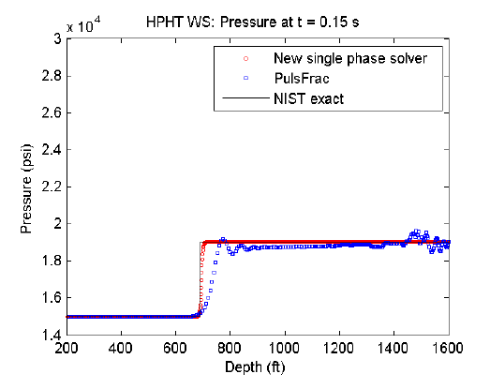
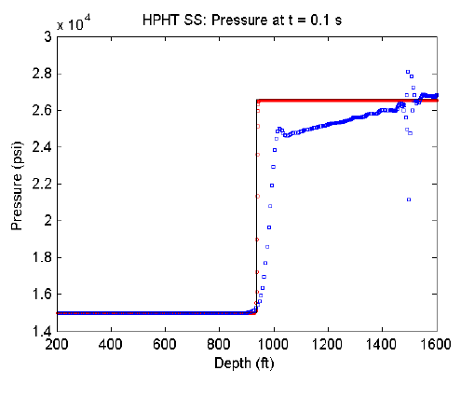
Test Case Results – Single Phase Flow Solver
IPS – 15 - 13
New flow-solver numerical algorithm removes shock smearing, spurious oscillations that lead to instabilities! Also, the new solver results agree with exact solution!
Current software solution:
shock smearing
post-shock oscillations
general oscillations that lead to instabilities
Weak Shock
Strong Shock
Current Sotware
Notes:
The numerical algorithm in the new wellbore simulator (shown in red symbol) removes:
Spurious oscillations
Smearing of shock
Spurious oscillations require artificial numerical dissipation for stability; also, spurious oscillations unnecessarily reduce the computational time step size.
The new solver also shows that it matches the exact solution obtained using NIST database.

Slide 16
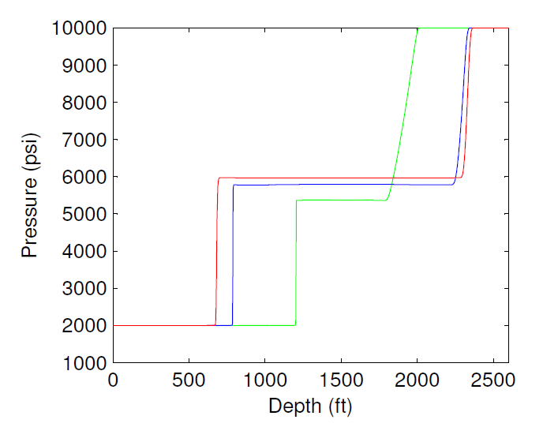
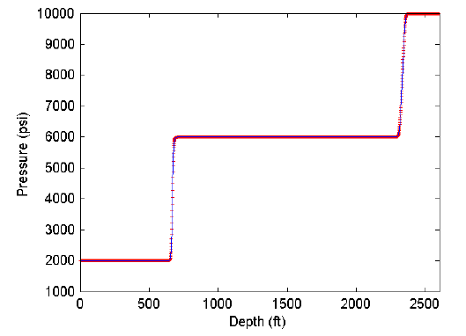
Test Case Results – Three-phase Solver (oil, gas, water)
IPS – 15 - 13
Multi-phase (Oil, Gas, Water) version of the model is up and running
  (Left) – Example shows shock tube problem with three different ratios of fluids.
  (Right) – Comparison of multi-phase and single phase solvers with mostly water
New three-phase solver incorporates the improved PVT models for HPHT. Its results agree with those of single-phase solver as well as exact solutions.
(W, O, G)
(0.7, 0.2, 0.1)
Single phase model
(0.99, 0.005, 0.005)
Multi-phase model (1,0,0)
(0.999, 0.0005, 0.0005)
Solution approaches that of single-phase solver as water proportion increases
Notes:
Computational results obtained by single phase wellbore flow solver (previous slide) and Multiphase wellbore flow solver are compared. Multiphases are oil, gas, and water.
The left plot shows that, as the water composition is increased from 0.7 (Green curve) to 0.99 (Blue curve) to 0.999 (Red curve), the pressure predicted by the multiphase flow solver approaches that of the single phase flow solver; the right plot shows exact match between single and multi phase solvers when only water exists in the multiphase solver.

Slide 17
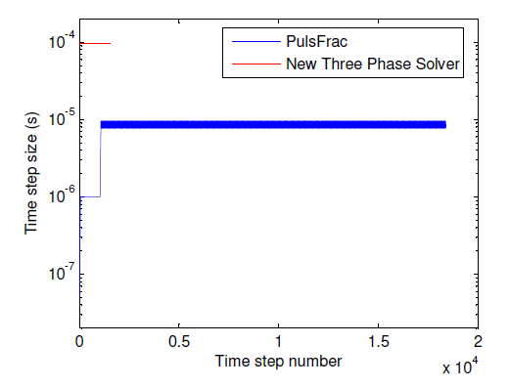
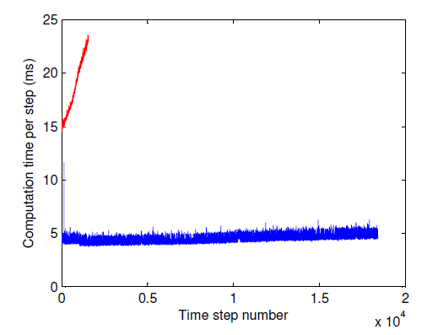
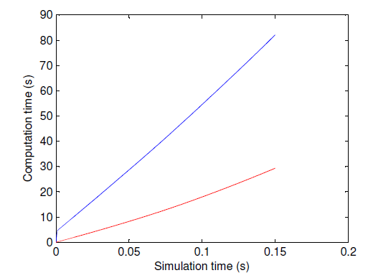
Numerics – Results for Computational Efficiency
IPS – 15 - 13
Time Step Size (s)
Time per Step (ms)
T_{end}/
Current Sotware
Total Computational Time (s)
Number of steps
Time per step
Parallel
Total Computational Time
300% speedup
Notes:
Upper left plot shows that the time step size used by the new multiphase flow solver (Red curve) is orders-of-magnitude larger than that used by the current software (Blue curve). New multiphase flow solver uses CFL condition to determine the time step size.
Upper right plot shows that the new solver (Red curve) requires more computation time for each time step than the current software (Blue curve).
Combining the upper two plots, the bottom plot shows that the new wellbore flow solver (Red curve) is close to 3 times faster than the current software (Blue curve). The new solver is computationally more efficient.

Slide 18
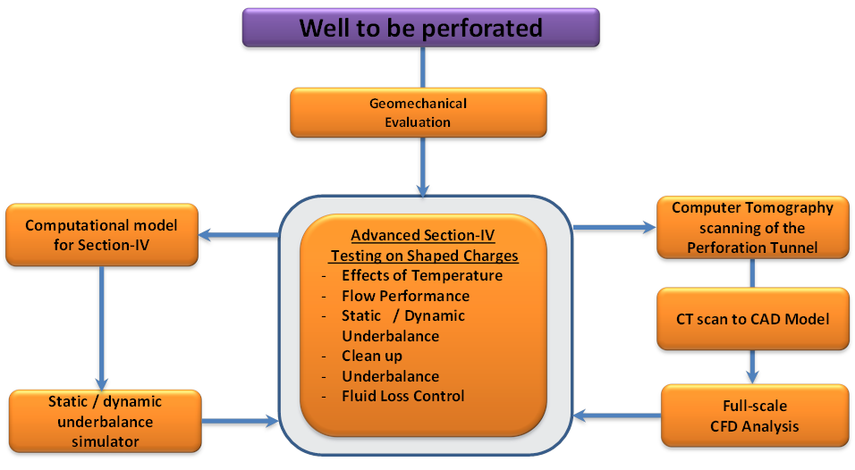
Testing and Modeling Systems
IPS –15-5
Lab Scale CFD Analysis
Presented in IPS –15-5
Presented in IPS –15-19
Full-Scale CFD Analysis
Full-Scale Dynamic Event Model
Notes:
We recently developed an engineering workflow that combines experimental and numerical modeling to evaluate and optimize the shaped charge performance. The workflow is primarily targeted towards exploiting the capabilities of a perforation flow laboratory in conjunction with numerical modeling. As seen from the workflow below, apart from the experimental testing in the flow laboratory, our modeling efforts are focused on two aspects:
Development of a novel full-physics CFD model that utilizes digital rock physics to simulate the flow around the true geometry of the perforation tunnel.
Development of a fast computational model based on laboratory apparatus to complement the transient effects seen in lab experiments (focus of this work)

Slide 19
Summary
IPS – 15 - 13
Robust modeling & simulation of dynamic downhole perforation operations is important for:
  pre-job work flows
    Optimize well completion
    Mitigate risk of shock loading
  Post-job data analysis that feeds back to job design work flows
  Sensitivity analysis used during flow laboratory experiments and testing
As completion designs move to complex wells, modeling and simulation become more critical.
We are actively evaluating and improving our computational platform
    Efforts are underway to evaluate the stability, accuracy, and overall performance of both the flow model and numerical algorithms implemented in the current platform.
    Improvements include better thermodynamics and robust numerical algorithms

Slide 20
Slide 20
IPS – 15 - 19
Acknowledgements / Thank You
Committee of the 2015 IPS Europe

