Slide 1
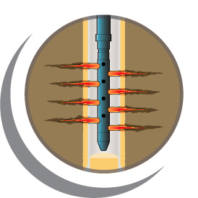
Perforating Weak Sands—A Review of Techniques
Andy Martin &
Kamaljeet Singh
IPS-15-24

Slide 2
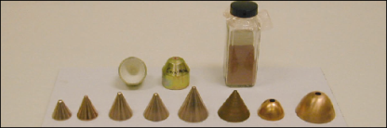
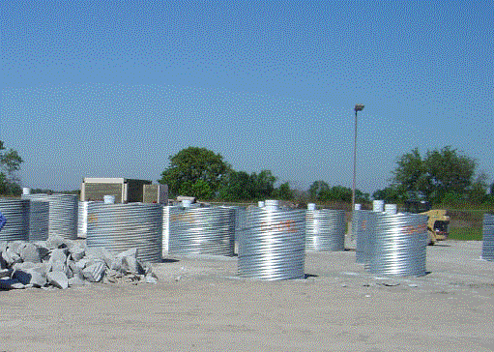
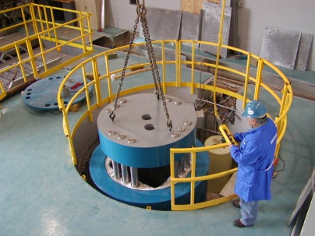
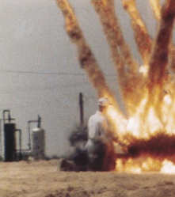
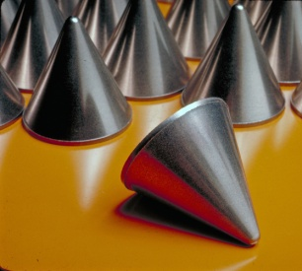


Agenda
Geomechanics
Sand Prediction Model
Practical Case
Summary
References
* Mark of Schlumberger

Slide 3
A Little Bit of Geomechanics

Slide 4


Weak and unconsolidated rocks
What is the range of strengths of very weak and weak rocks?
Zero strength Very very weak Very weak Weak
Dry sand Damp sand Weakly-cemented Stronger cement
high Φ lower Φ

Slide 5
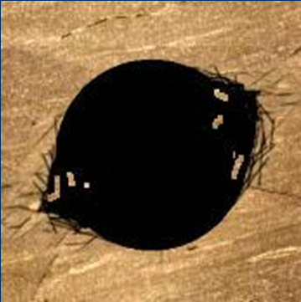
Failure Mechanisms—Shear
Shear failure (2)
  Compressive stress causes failure of single perforation tunnel
  Stress between perforations can cause a failure at the sand face, between perforations
Shear failure is the primary
mechanism for sanding

Slide 6
Failure Mechanisms—Tensile
Tensile failure (1)
  Force of flow erodes
  tunnel surface
  Common in very weak
  rocks or high flow rates
  Sand production may start upon initial inflow, with depletion, after shut-ins, or with water break-through

Slide 7
What Influences Shear Failure?
Parameters we cannot influence
  Earth stresses
  Rock strength
Parameters we can influence
  Where to perforate (select stronger rock)
  Direction of perforations (most stable)
  Shaped charge type (tunnel diameter, penetration)
  Shot density and phase (perf-to-perf spacing)
  Clean perforations (reduce stress)
  Drawdown (reduce stress)
  Well startup (reduce stress)
  Water (avoid, monitor and shut off)
  Depletion (pressure support)

Slide 8
What Influences Tensile Failure?
Parameters we can influence
  Drawdown
    Total flow rate
    Flow per perforation
    Sand production to surface
  Shot density
    Flow rate per perforation
Some opposing influences
  Increase shot density
  Increase perf-to-perf spacing

Slide 9
Sand Prediction Models

Slide 10
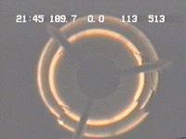
Sand Prediction Model
Rocks under axial flow
Sand separation
Transport mechanisms
Displacements of walls
2 to 21 Mpa UCS rocks
Wide range of sand separation mechanisms
Compare to modelled response of the perf tunnels - FE and semi-analytic

Slide 11
Perforation Stability Modelling
3-D elastic stress analysis, fluid flow term, apparent strength
Data
  log-data, grain size
  perforation size, orientation
  insitu stresses, depletion
Engineering tool
  Geomechanics
Model validation (section 4 test)
σ
v
North
σ
σ
H
h
σ
z
σ
θ
σ
r
Perforation
Tunnel
σ
z
σ
θ
σ
r
Wellbore

Slide 12
Sand production - Stability Envelope
Critical Reservoir Pressure
Wellbore
Pressure
(psi)
Safe
Drawdown
N O
F L O W
O I L
Failure
O I L
+
S A N D
Reservoir Pressure (psi)

Slide 13

Sand Prevention with Oriented Perforating
(In this case, assume vertical well, σ_{V} > σ_{H}> σ_{h})
Borehole Stresses
Max.
stress
5
5
Good
perforations
3
3
MIN
Stress
MIN
Stress
Min.
stress
1
1
-1
-3
MAX
Stress
MAX
Stress
-5
High stress concentration
-5
-3
-3
-1
-1
1
1
3
3
5
5
Damage occurs at stress concentrations
Damaged rock
Perforation in intermediate direction is generally worst

Slide 14
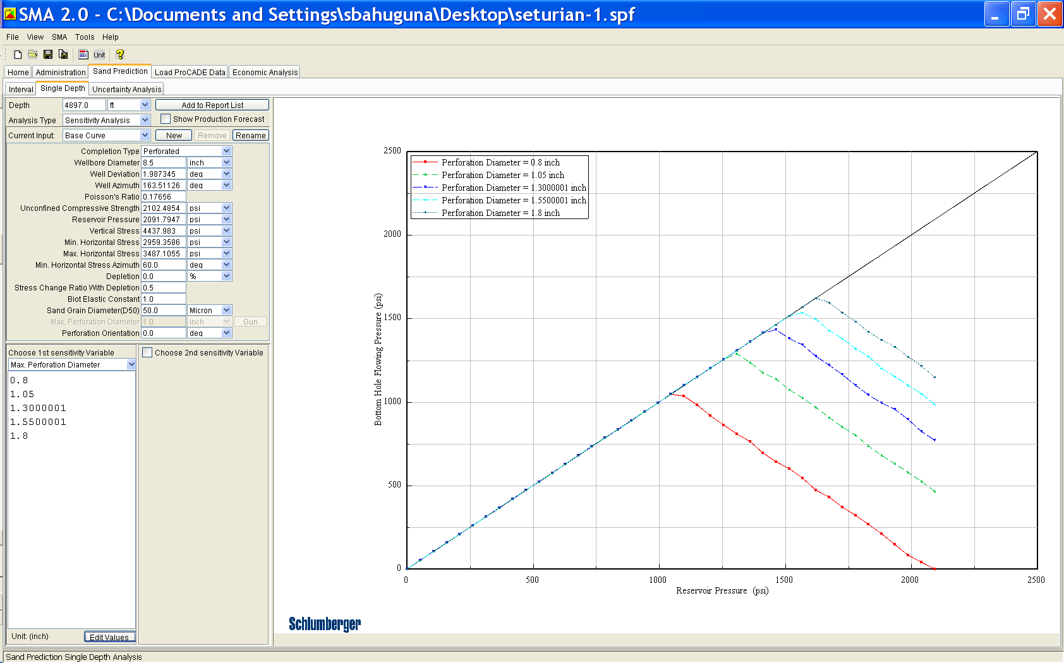
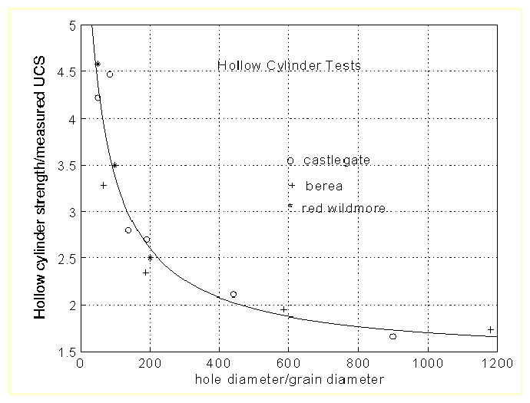
Sanding Sensitivities – Perforation Diameter
Decreasing Perforation Diameter
Normalized hole size

Slide 15
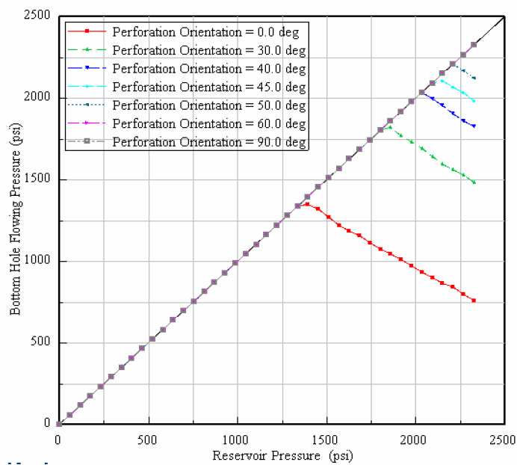
Sanding Sensitivities – Perforation Orientation

Slide 16

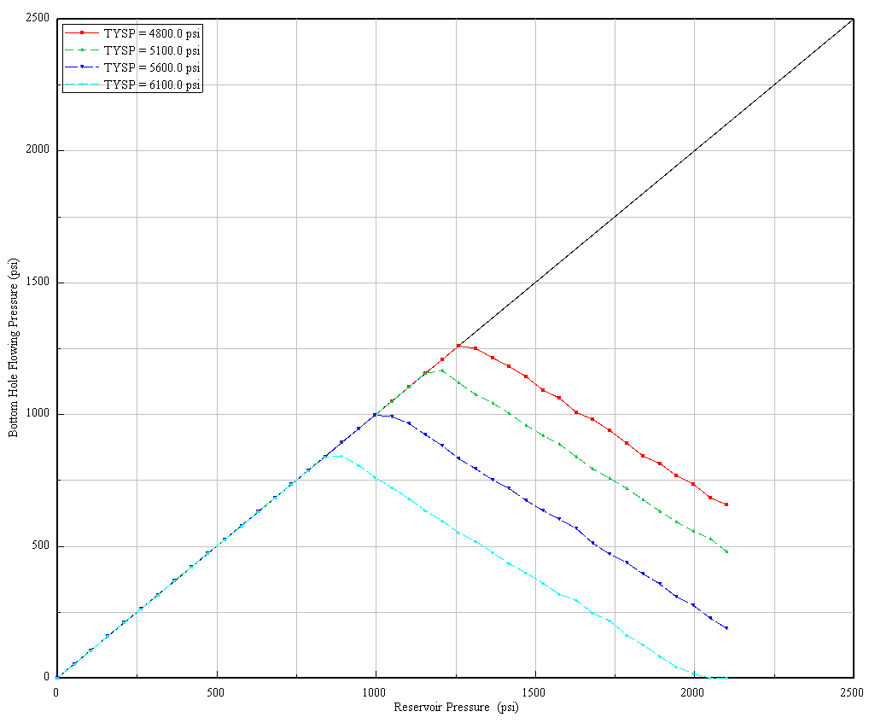
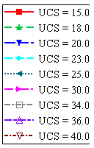
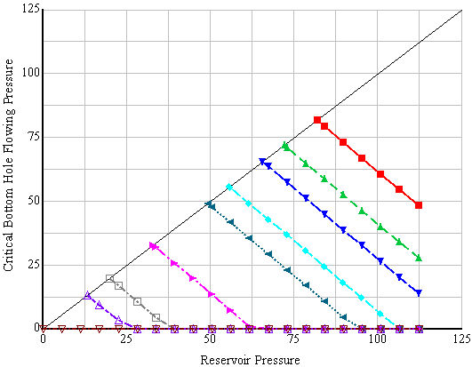
Sanding Sensitivities – Stress Anisotropy & UCS
Increasing UCS
Increasing SHmax
Maximum horizontal stress
Rock Strength

Slide 17
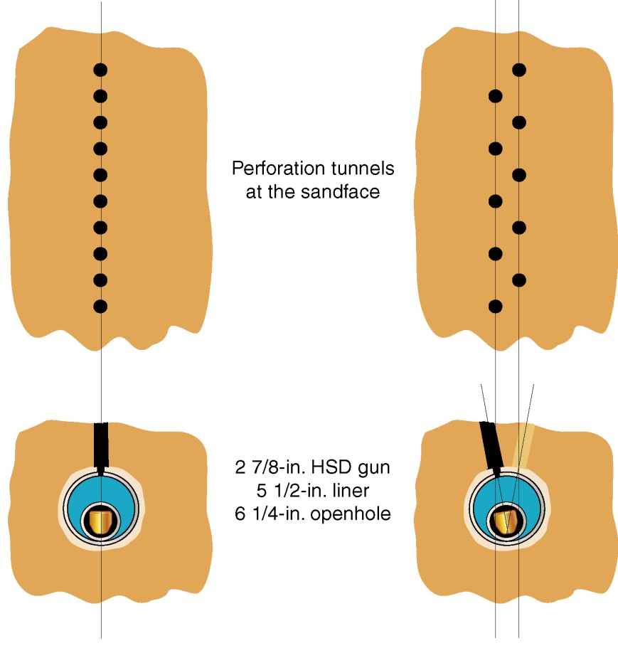
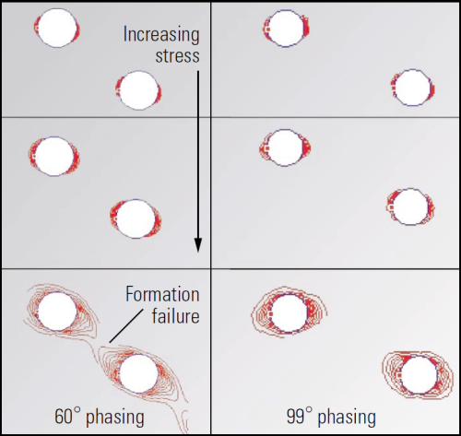
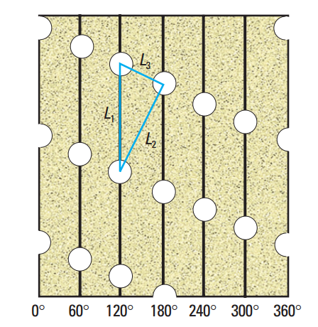
Optimum Phasing
Maximize perf.-to-perf spacing for a given spf and phasing

Slide 18
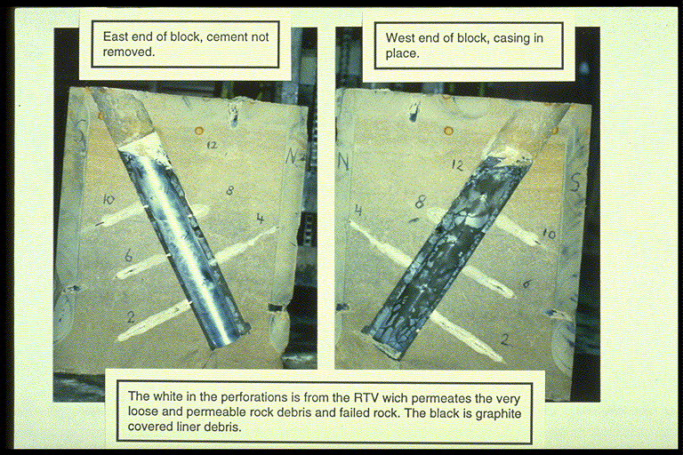
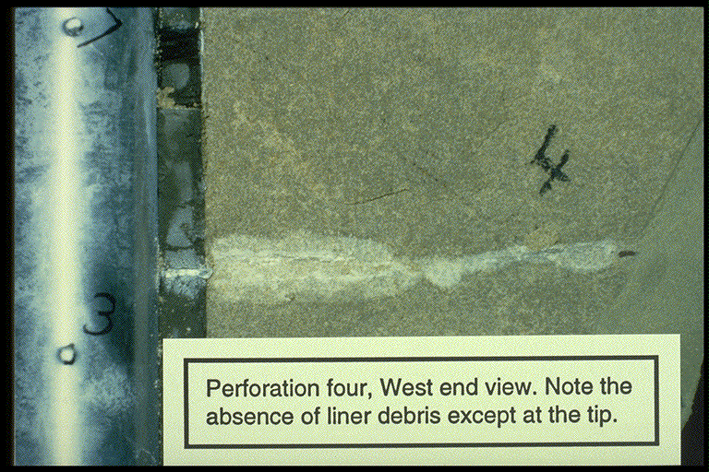
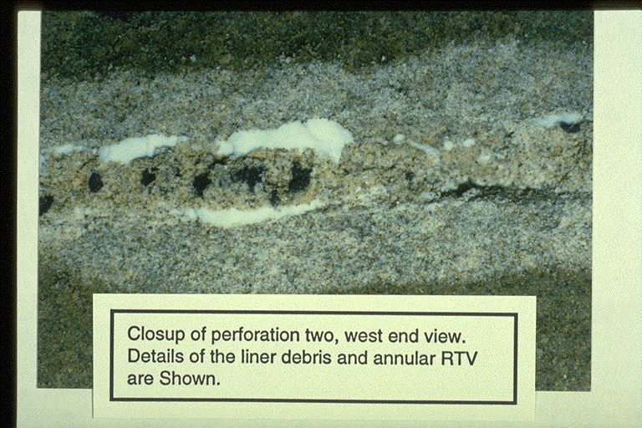
Block Tests—Orientation Effects
Topside perforation
Downside perforation
Multiple Perforations in Sandstone shot at 400 psi U/B

Slide 19
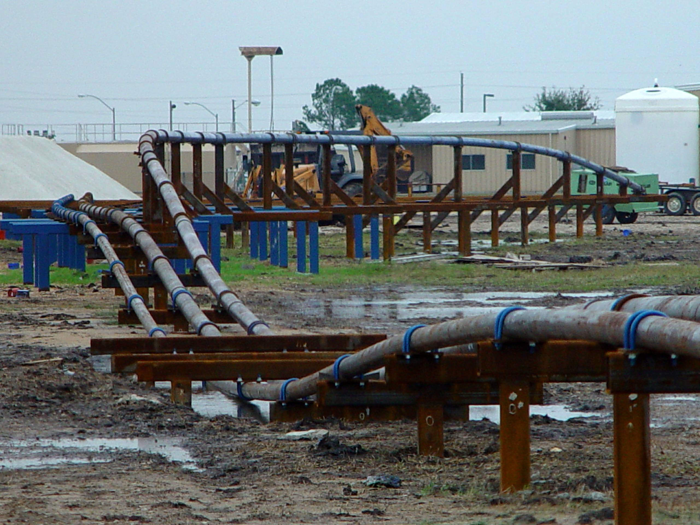
Bent Wellbore Setup

Slide 20
Optimized Perforating
Perforation selection from model
  Orient to minimize stress contrast
  Decrease perforation hole size – Appropriate Charges
  Perforate strongest zones (selective perforations)
  Optimize perforation to increase perforation spacing (> 4 hole diameter)

Slide 21
Practical Case

Slide 22
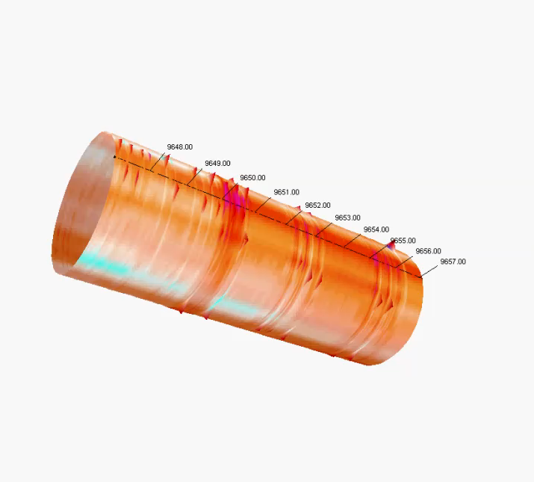
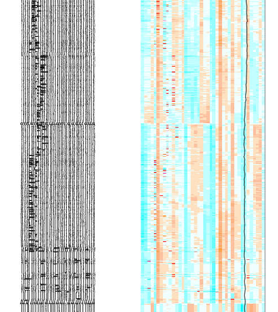
Oriented Perforating North Sea Well

Slide 23
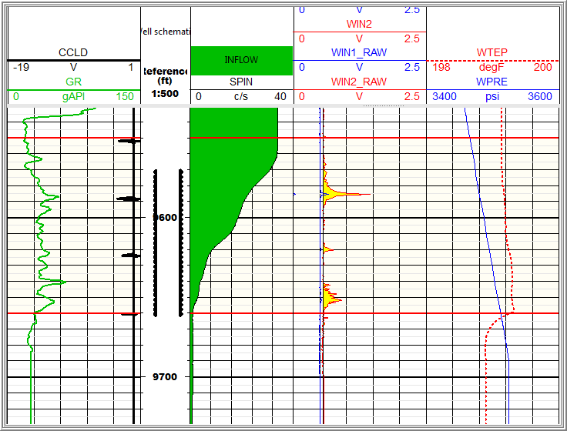
Sand Detection Log North Sea Well

Slide 24
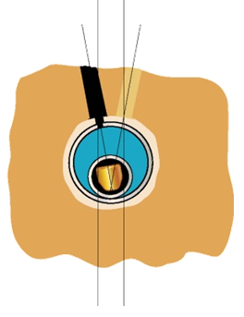
North Sea Existing Wells
Existing perforation in deviated wells
  3 3/8” 5 spf, +/-10 to top
  2 7/8” 6 spf, +/-10 to top
Increase spf by shooting low side in same directions
Doubling spf would reduce drawdown, reduce erosional flow and limit sanding risk

Slide 25
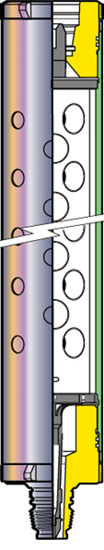

Zones Producing Sand
Double shoot or:
Extreme shot density guns with small DP shaped charges
  Small holes more stable
  Reduce pressure drop
  Reduce flow rate per perforation

Slide 26
Summary
Understand the Geomechanics
Shoot in the most stable directions
Respect perf-to-perf spacing
Maximize shot density
Don’t be afraid to reperforate
or use extreme spf
Shut off water

Slide 27
Some References
OTC 19130 Oriented Perforating as a Sand Prevention Measure
SPE 47360 Benefits of Assessing Solids Production Risk in a North Sea Reservoir Using Elastoplastics Modelling
SPE 50387 Experimental Investigation of Sanding Propensity for the Andrew Completion
SPE 57954 Oriented Perforating for Sand Prevention
SPE 58788 Perforating Requirements for Sand Prevention
SPE 93639 High-Accuracy Oriented Perforating Extends the Sand-Free Production of the Andrew Field
SPE 102242 Bokor—A New Look at Sand Production in a Mature Field
SPE 107785 Optimized Perforation Tunnel Geometry, Density and Orientation to Control Sand Production

Slide 28
Perforating
Geomechanics
Sand Prediction Model
Practical Case
Questions?
* Mark of Schlumberger

