Slide 1
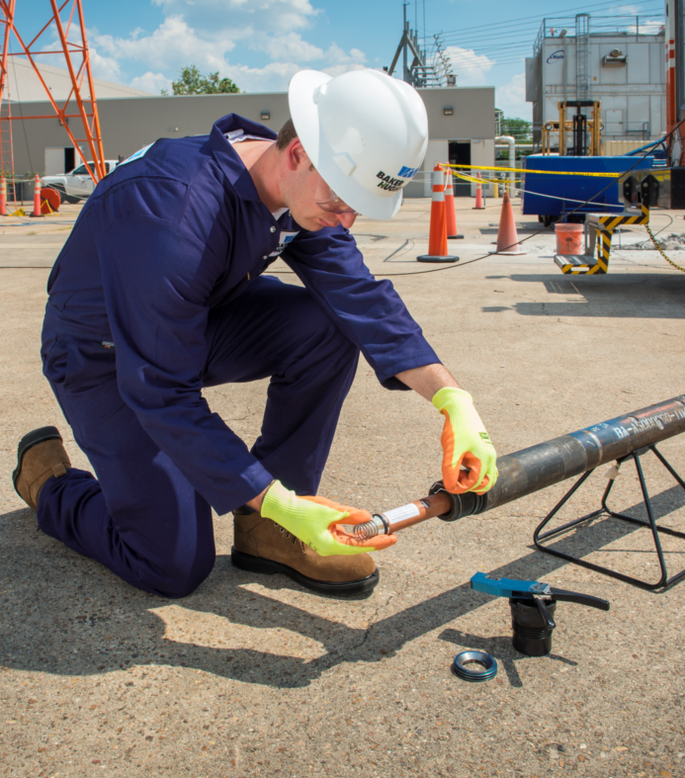
Select-Fire System
Improved Safety and Reliability on Plug and Perforating Operations
Khaled Gasmi
Lou Finger

Slide 2
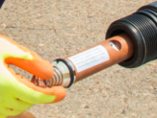
Select-Fire System
A step change in select fire operations
Offers all the redundancy and monitoring capability of the current leading intelligent switch technology
Avoids the need for downhole controller subs
Notes:
The BakerHughes select fire system is a step change in select fire operations, utilizing a unique electrical/ballistic transfer system, eliminates the weakness inherent in current technologies that use ported subs and require on site wiring. The electronic cartridge offers all the redundancy and monitoring capability of the current leading intelligent switch technology without the need for downhole controller subs.

Slide 3
How is it Different?
Preprogrammed unique address for each switch
Saved on first contact with switch
Eliminates the need to know individual switch’s address
Unique electrical/ballistic connection eliminates
ported subs
Requires no wiring on site
Employs two-way communications with the surface for control and safety
Notes:
Safe – no internal Power source.
No window ports – Increased reliability
Easy to assemble at the well site – “Plug and Play” no wiring at the well site.
Simple To Use – User friendly software automatically confirms gun count in string.
Two way communications due to robustness of the system.
Allows “Shooting on the Fly” efficient operations.
Ability to test system prior to going to perforating depth – save significant down time – increase efficiency.
Ability to skip a gun if necessary – Allows redundancy.
Monitors Detonator connection to switch – Allows Quick decisions, save trouble shooting time.
Eliminates reliability and efficiency issues associated with mechanical devices.
Virtually eliminates need for Radio Silence on most locations.

Slide 4
Specifications
Up to 32 selections
No internal power source
No window ports
Operates with approved detonators, including EBW’s
Meets RP67 requirements
Notes:
Up to 32 selections
Operates with BHI approved detonators or Guardian Fired Guns including EBW’s.
Expendable downhole equipment
Temperature rating 347° F.
Pressure Rating 22,000 psi (gun rating)
Unique Address
Ability to test gun string at safe depth
System meets HS&E requirements and RP67 requirements
FHA for setting tools #10 and #20

Slide 5
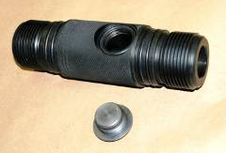
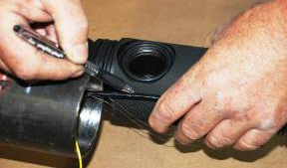
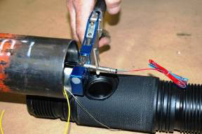
Conventional eb switch preparation
1.
2.
Measure and cut Det. Cord
Conventional Switch Sub
3.
Bring Ground Wire and Thru Wire out of the gun, crimp detonator

Slide 6
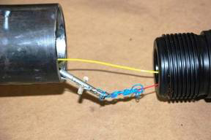
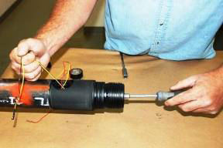
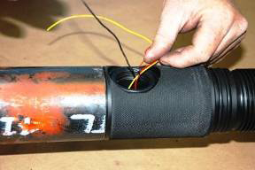
Conventional eb switch preparation
4.
5.
Connect Ground to Detonator - Feed Thru Wire and Detonator Thru the sub
Install EB Style Switch
6.
Sort wires, make wiring connections

Slide 7
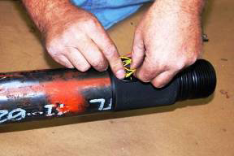
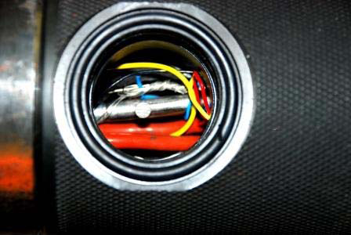
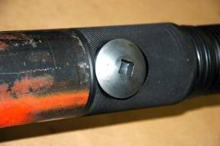
Conventional eb switch preparation
7.
8.
Coil wires, pack into switch sub
Inspect wiring, remove shunt
9.
Arming complete

Slide 8
Problems With Pressure Actuated Switches
The number one problem associated with pressure actuated switches is wiring.
Leaks - Usually from arming ports.
Explosive transfer from detonator to det cord.
Blown out Switches / Switch Failure causing misfires.

Slide 9
SUREPERF™ Select Fire System
1
Pull shunt, slide the cartridge into sub, connect guns.

Slide 10
Overview Gun String

Slide 11
Conclusion
Offers a step change in technology and reliability
Easy to assemble in the field
Eliminates the majority of issues inherent in select-fire systems
2300 cartridges shot to date with only 2 failures related to the system
Notes:
The SurePerf Rapid Select-Fire system offers a step change in technology and reliability.
It is easy to assemble in the field and eliminates the vast majority of issues inherent in current Select-Fire Systems.

Slide 12
QUESTIONS

