Slide 1
Propellant stimulation tool for Mature Oil Wells in Meotian III reservoir for an operator in Romania
Gideon Lammers
Technical sales advisor perforating Continental Europe
May 20, 2015 (International Perforating Symposium IPS-15-29)

Slide 2
What propellant did to this well!
Notes:
2 mtr of stim. 2” OD. Pulsfrac model showed we could pass near bore well damage. Production increase confirms the model. The propellant stimulation tool technique, applied at Meotian III reservoir, has proven that this technique can offer a highly effective stimulation in these mature oil fields to improve in oil production. Additionally, its usage eliminates the need of conventional, separate acid stimulation saving rig times and costs while reducing HS&E risks

Slide 3
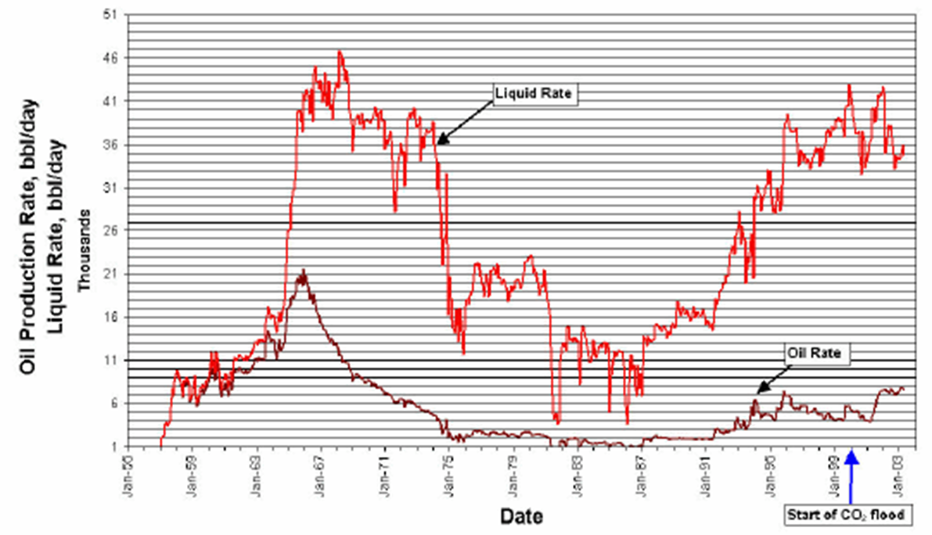
Well profile…..looks similar?

Slide 4
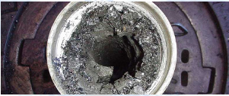
What kind of well we have!!
Declining production, been produced since 1982
Depleted reservoir, require artificial lift to maintain production
Sand and water production issue
To make it worst, they have severe problem with Paraffin Wax and Asphaltene build-up
Hundred over wells with similar issues

Slide 5
What we do about it ….previously
Pull completion, Coil Tubing run & acid wash
This proved insufficient :
Large footprint required (logistic and personnel)
Cost
HSE exposure with chemical
Result only last for couple of months
When left untreated, paraffin build-up can drastically decrease the efficiency of the entire oil recovery and transfer system including flow lines, pipes & tubing

Slide 6
Candidate selection
Good Fracture Candidate
Additional Fluid preferred
Can well be left like this?
Cement?
PBTD close to Perfs

Slide 7
Risk Reward!!!!
Risk
Moderate Wire Movement
Unknown Damage mechanism & thickness
Benefit
Fracture with Extension
Production at 1.3 m³
Moderate Candidate in Upper Zone
Place holder for image or graphic

Slide 8
Modeling
Casing | OD 139.7 mm (5.5”) | 17 LBS/FT J55
Temperature | 63 Celsius | 145 Fahrenheit
Permeability | 50-400 MD
Porosity | 25 %
PBTD | 1777 MTR
Fluid | Oil
Bottom hole pressure | 2950 KPA | 428 PSI!!!
Intervals | 1776 MTR – 1768 MTR | 1766 MTR – 1762 MTR
OIL API | 40.64

Slide 9
Upper Pressure & Temperature Response
Peak pressure at 7800 psi
Relative early fracture initiation
No warning flags
2” OD 6FT stimtube
Wellbore Pressure
Fracture initiation

Slide 10
Upper Pressure & Temperature Response
Peak temperature at formation rises to 109 degrees Celsius.
109C
Wellbore Temperature

Slide 11
Upper Wire Motion & Tension
Monitoring Wire line movement to avoid NPT/fishing operations
Early time no problems expected.
Tension compression in limits of the 7/32” wire
Motion of wire
Tension/Comp
Early Time

Slide 12
Upper Wire Motion & Tension
Motion of wire
Movement still moderate in late time (8 sec)
Slight increase in tool movement, still in the limits
Compression tension of the 7/32” wire still in working limits
1m
Tension/Comp
Late Time

Slide 13
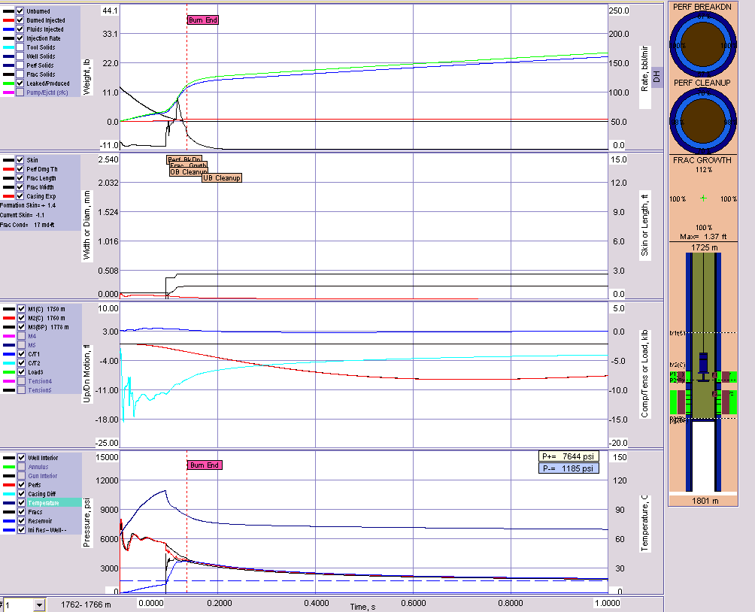
Overview

Slide 14
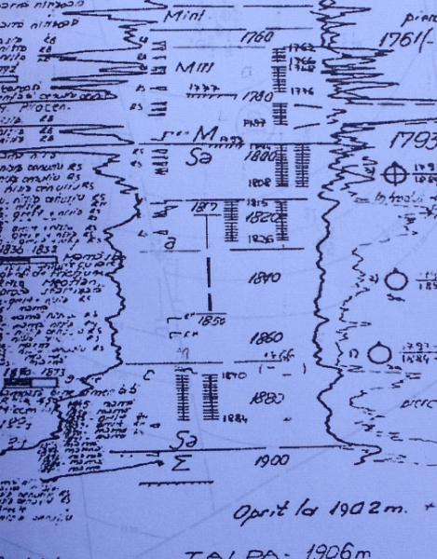
Execution
Gauge cutter run, surprised HUD
Hand drawn correlation logs
7/32” mono conductor used
2” OD 3FT stim tube

Slide 15
Conclusion
Increased flow path achieved resulting in additional production out of mature reservoir in extents up too 3 bbl/day
Eliminating the need for acid stimulation, which could potentially harm the environment, personnel and equipment on location
Eliminating costly work over solutions which previously need to be undertaken every couple of months.
Small foot print of wireline has the benefit to access smaller locations situated along narrow streets and inhabited areas.

Slide 16
Thank you. Questions?

