Slide 1
IPS-15-30 Europe The Safe Retrieval of Misfired Perforating Guns from Shallow Well Operations (from SPE 174009)
Dominic Wong
Regional TCP Manager – ESSA
May 21, 2015

Slide 2
Introduction
The vast majority of perforating operations are accomplished without issue.
A special case of misfire occurs when guns partially fire, leaving an unknown state of the remaining ballistic train.
This type of misfire, especially in shallow wells, may require special planning to account for unknown factors.
This presentation discuss the decomposition calculations with multi-step time iteration to predict the catastrophic event
Recommended procedure for retrieving these guns in-line with the OSHA Process Safety Management [OSHA 1910.119]
Notes:
Shallow well – 2000ft or less

Slide 3
What could happen with guns partially fire downhole?
It may generated sufficient internal heat to begin a “Thermal Cookoff” process.
If the heat generation owing to the decomposition cannot be balanced by heat dissipation to the surroundings. Then it is possible for the process to become unstable. (ie internal pressure start to increase)
This reaction can accelerate uncontrollably until an explosion occurs –designated as “Thermal Runaway” or “Fast Cookoff”
Imagine if the timing of the thermal runaway coincide with gun retrieval to surface

Slide 4
Methodology
Step 1
Initial heat release
Step 2
Incubation period
Step 5
Feedback loop
Step 3
Thermochemistry
Step 4
Pressure increase
Step 6
Runaway reaction and gun burst

Slide 5
Methodology
Simplifying assumptions:
A given quantity of explosives initially reacts with adiabatic flame temperature of 3894 K.
There is no heat loss to the external surroundings.
The decomposition kinetics can be approximated by a series of finite time/cycle increments.
Static pressure calculations are used to predict burst.

Slide 6
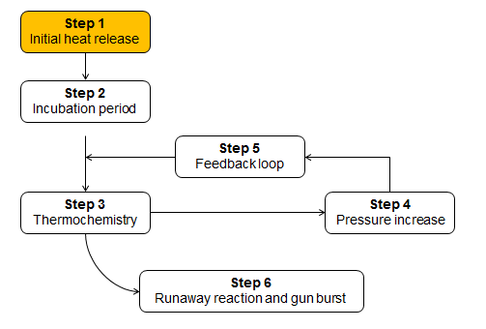
Step 1: Calculate initial heat release
$Q=mH$
Where,
Q = heat released
m = mass reacted
H = heat of explosion

Slide 7
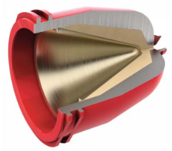
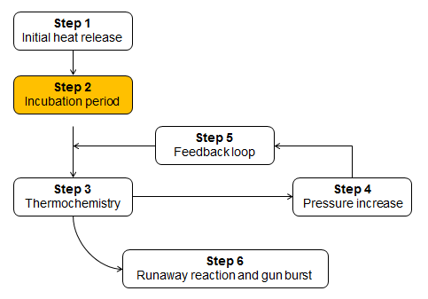
Step 2: Calculate incubation temperature
$$T_{f}=\frac{Q}{m_{c}{Cp}_{C}+m_{u}{Cp}_{u}}+T_{o}$$
Where,
T_{f} = incubation temperature
Q = heat released
m_{c} = mass of case
Cp_{c} = specific heat for the case
m_{u} = mass of unreacted explosives
Cp_{u} = specific heat for the unreacted explosives
T_{o} = downhole or initial temperature

Slide 8
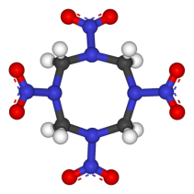
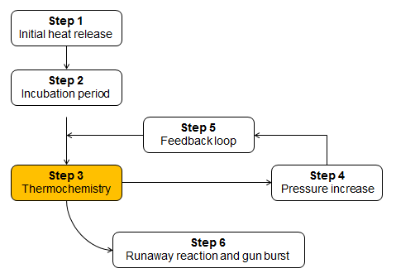
Step 3: Define the reaction’s thermochemistry
$$\frac{Mass reacted}{Molecular weight}=Moles of explosives$$
For one mole of HMX:
Elemental break down: C₄H₈N₈O₈→4C+8H+8N+8O
Kistiakowsky-Wilson rules: 4C+8H+8N+8O→ 4CO+4H₂O+4N₂
KW Rules: reactant initially breakdown to its elemental state, which is CxHyNwOz xC+yH+wN+zO and then recombine to molar amounts of N2, H2O and CO

Slide 9
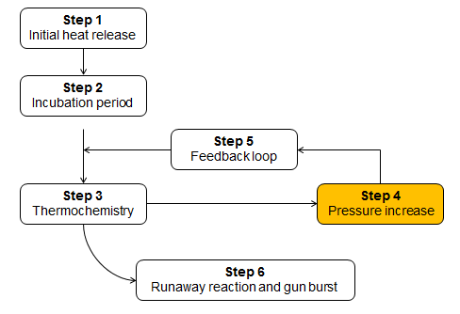
Step 4: Calculate pressure increase
The Noble-Able Equation of State
$$P\left(V−0.025n\right)=nRT$$
Where,
P = pressure
V = free air volume of the vessel
n = number of moles of gas
T = absolute temperature
R = universal gas constant (0.0821 L-atm/mole-K)
Ideal Gas Law: PV = nRT, however for elevated pressure range exceeding 10K psi, Noble-Able EOS is more applicable (for ballistic application)
Notes:
Ideal Gas Law: PV = nRT, however for elevated pressure range exceeding 10K psi, Noble-Able EOS is more applicable (for ballistic application)

Slide 10
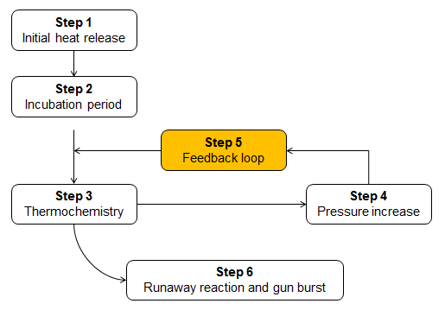
Step 5: Thermal decomposition and feedback loop
Arrhenius Equation
$$kdt=d\left(\frac{A^{′}}{A}\right)=Ze^{{−E_{a}}/{RT}} dt$$
Where,
k = reaction rate constant
t = time
A’/A = ratio of reacted vs. unreacted material
Z = reaction rate frequency
E_{a} = activation energy
R = universal gas constant
T = incubation temperature

Slide 11
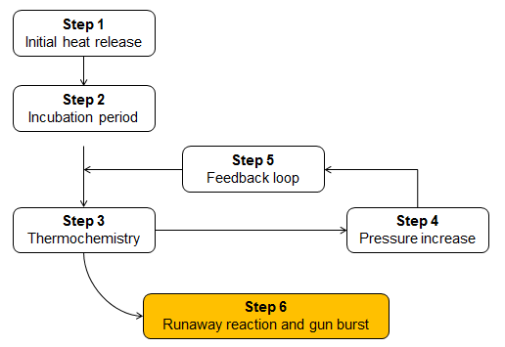
Step 6: Gun burst calculations
$σ_{h}=P_{i}\left(\frac{r_{o}^{2}+r_{mid}^{2}}{r_{o}^{2}−r_{mid}^{2}}\right)$ $σ_{r}={−P}_{i}$ $σ_{a}=P_{i}\left(\frac{r_{i}^{2}}{r_{o}^{2}−r_{thd}^{2}}\right)$
$σ_{VM}= \frac{1}{\sqrt{2}}\sqrt{\left.{\left(σ_{a}−σ_{h}\right)}^{2}+{\left(σ_{h}−σ_{r}\right)}^{2}+{\left(σ_{r}−σ_{a}\right)}^{2}\right.}$
σ_{h} = inner hoop stress
σ_{r} = inner radial stress
σ_{a} = inner axial stress
σ_{VM} = von Mises stress
P_{i} = internal pressure
r_{o} = outside radius of gun tube
r_{i} = inside radius of gun tube
r_{thd} = inside radius of thread relief
r_{mid} = midpoint radius ½(r_{i} + r_{thd} )
Notes:
Gun burst when the von Mises stress exceed the yield point of the gun steel at temperature

Slide 12
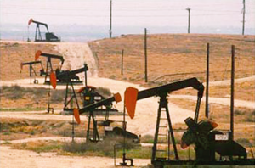
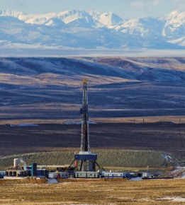
Postulated Example
Shallow well, < 2000ft
10 ft 4-5/8” perforating gun by 5 shots per foot
50 charges
HMX explosives
2000g total for charges
100g initiation train
Downhole temperature 100°C
Downhole misfire, 300g explosive deflagrate
Retrieval time about 20 minutes

Slide 13
First Iteration Calculations
Initial heat released = 1859 kJ
Temperature rises 100°C to 238 °C
0.06% further decomposes over the next 45 sec
12.14 moles of gas produced
Pressure increases to 3,017psi
von Mises stress is 20,852 psi
Notes:
Step 1: The initial heat released from the initiation train and five charges is 1859 kJ. This represents 14.3% decomposition (=300/2100 g).
Step 2: The incubation temperature for the unreacted charges inside the gun increases from 100ºC to 238ºC due to the heat absorbed.
Step 3: The 14.3% decomposed explosive increases the number of moles of gas inside the gun from 0.82 to 12.96 g-moles.
Step 4: The evolved gas inside the gun raises the internal pressure to 205 atm or 3017 psi.
Step 5: The incubation temperature from Step 2, 238ºC (=511 K) generates an additional 0.06% decomposition over the next 45 seconds. This is fed back into Steps 1 and 2 to continue the process for the next 45 second interval.
Step 6: The internal pressure of 3017 psi is used to calculate internal stresses at the thread relief. For the first time cycle the von Mises stress is 20,852 psi which is well below the yield strength of the steel.

Slide 14
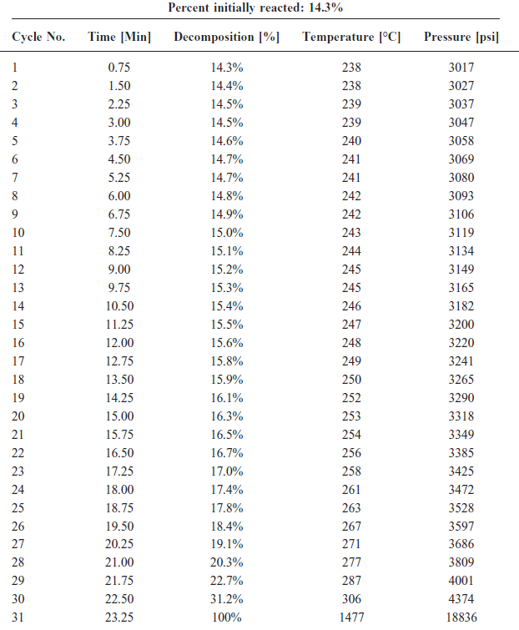
Time iteration history

Slide 16
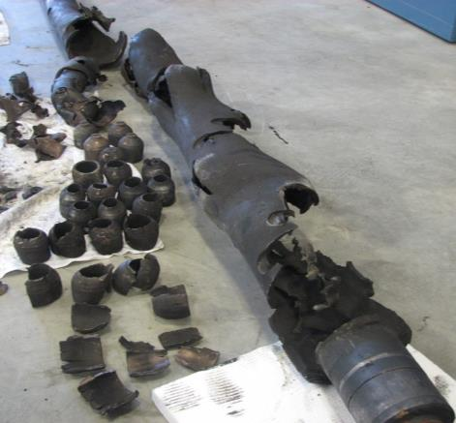
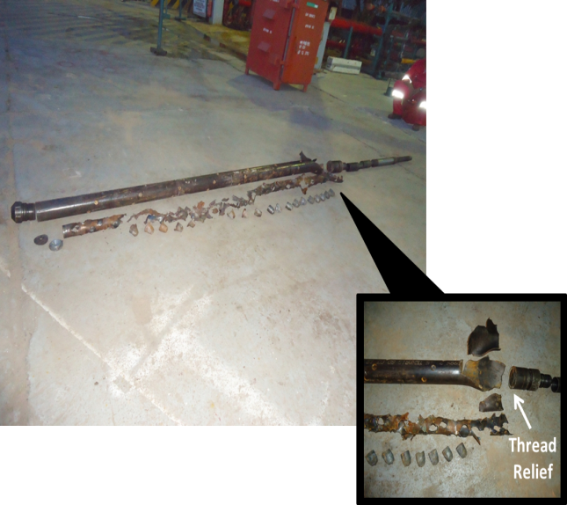

Slide 18
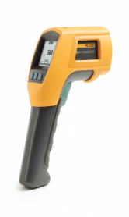
Recommended Practices for Field Operations
Misfired guns are filled with uncertainty
Use Process Safety Management principles:
Process Hazard Analysis
Operating Procedures
Training
Pre-Startup Safety Review
Management of Change
Emergency Planning and Response
Notes:
As the preceding example illustrates, misfire guns are filled with uncertainty. Nonetheless, retrieval operations must begin at some point, and this activity has to be done safely.

Slide 19
Begin safety stand down
▪ Initiate 30 min wait time
▪ Bring gun to cooler temp ..typically ~200 ft below surface
Note last firing attempt, t_{o}
Measure T₁
T₁ ≥ 225°F
Wait 15 minutes
▪ Measure T₂
NO
YES
WAIT 24 HOURS
Wait 15 minutes
▪ Measure T₃
T₂ > T₃
Lower to cooler temp
▪ Wait 2 hours
▪ Measure T₄
YES
Lay down gun
NO
YES
T₃ > T₄
NO
Notes:
-conduct safety meeting –ref procedure, identify gun lay-down area, clear non-essential personnel -take temp measurements with the infrared thermometer at the same place on the gun body to ensure consistency – always avoiding scallops or reflective areas
225 deg F is the suggested critical temp – 100F below the 1hr rating for RDX >>> above it – indication of thermal cookoff is actively underway

Slide 20
Summary
Misfires occur in the field, which leads to uncertainty.
All explosives decompose with temperature.
Incubation periods can create a false sense of security.
Temperature drives this reaction exponentially.
Use Process Safety Management principles to formulate a plan for retrieving misfired perforating guns.
Take measurements to reduce uncertainty.
Exploit time and cooler temperature to reduce the hazards.

Slide 21
Future work
Incorporating the heat removal effects of conduction and convection to the perforating gun.
The decomposition kinetics of other explosive systems: RDX, HNS, and PYX.
The cookoff process under a slower retrieval process, such as that which would occur with tubing-conveyed perforating.

Slide 22
Thank You / Questions

Slide 23
Background
Frank-Kamenetskii equation
$$ρC\left(\frac{∂T}{∂t}\right) = \left(ρQZe^{−\frac{E_{a}}{RT}}\right) − (−λ∇^{2}T)$$
Rate of temperature rise in an explosive
Rate of heat generation due to decomposition
Rate of heat removal due to conduction
=
-
Notes:
The explosive will decompose quietly until none remains

