Slide 1
2015 International Perforating Symposium The Renaissance Hotel, Amsterdam May 19 – 21, 2015
IPS –15-5
Fast-physics Computational Model to Predict Complex Transient Dynamics of API Section IV Lab Tests
Derek Bale, Rajani Satti, Minsuk Ji, Baker Hughes

Slide 2
Overview of the Presentation
IPS – 15-5
Introduction
Perforation flow laboratory
Existing laboratory event modeling
Objectives
Our design philosophy
Fast-physics: Model and results
Fast-physics: Plans for future
Conclusions

Slide 3
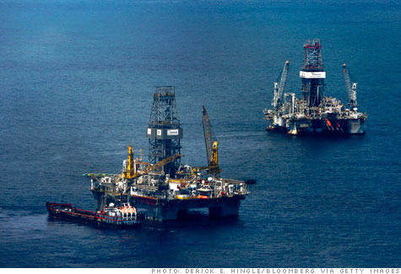
Introduction
IPS-15-5
Next-generation well completions
High-pressure/high-temperature
Ultra-deepwater
Long horizontals
Understanding the transient fluid dynamics during the
perforating process is critical to perforating well design.
Transient dynamics influenced by
job design parameters:
Gun design
Formation properties
Under/Overbalance conditions
Notes:
As the industry looks forward to next—generation well completions (HPHT, Deepwater, Long horizontals), perforating job design plays a critical role is these challenging scenarios. In particular, given the small time scales (few milliseconds) involved in perforating, it is of utmost importance to properly understand the transient fluid dynamics that occurs as a result of the interaction between the wellbore, gun system and the formation. Job design parameters such as gun design and specifications, formation properties (like porosity, permeability, UCS), and wellbore conditions (overbalance, static underbalance, dynamic underbalance) ultimately effect the transient dynamics.

Slide 4
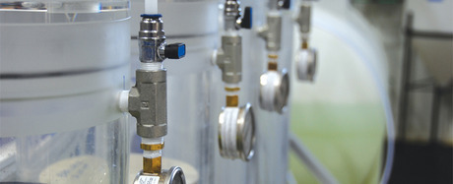
Perforation Flow Laboratory
IPS –15-5
Flow laboratory: Clear vehicle to study and understand the coupled effects between transient dynamics and job design parameters.
Measurements from a Section-IV test:
Pre- and post-flow permeability
Core flow efficiency
Productivity
Dynamic high-speed pressure
Perforation tunnel characteristics
Clean-up and underbalance optimization
Notes:
A clear vehicle to study and understand such dependencies (transient dynamics vs job design parameters) is the API-RP 19B Section IV test in which a single shape charge is used to perforate a rock core, and subsequent core flow can be measured and characterized using high-speed pressure gauges and flow meters.

Slide 5
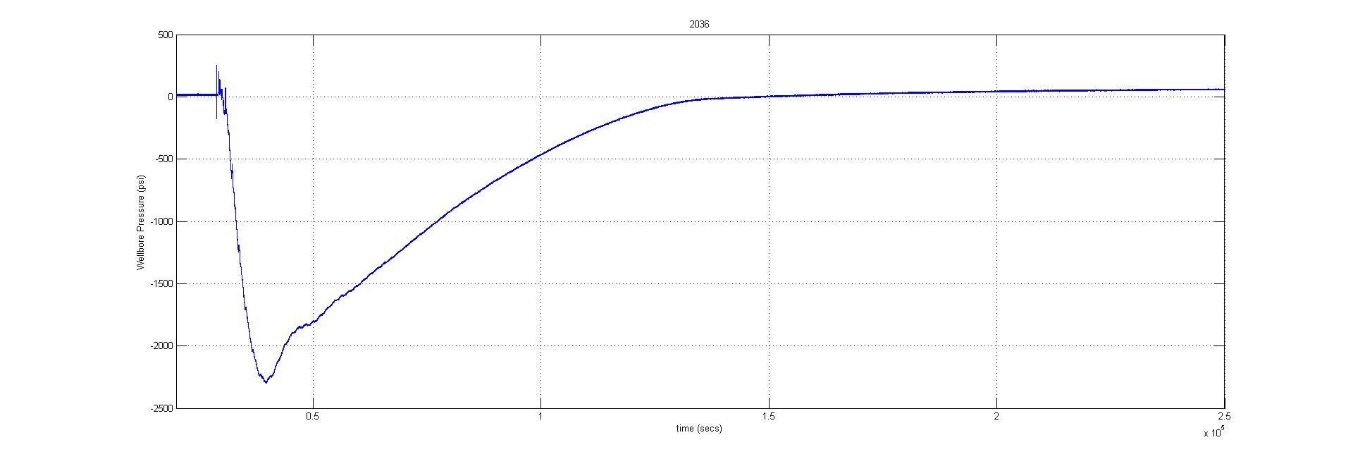
Perforation Flow Laboratory
IPS –15-5
The dynamic pressure data provides insight into the perforation process.
Though the details of the pressure curve look complicated, the general trends of the dynamics are dominated by only a few physical processes.
Challenges:
Experimental costs
Limited data
Impractical when DOEs are required
reservoir
wellbore
High-Speed Gauge Data
Wellbore Pressure (psi)
Notes:
The generation and flow characteristics of the perforation tunnel strongly depend on the features of the pressure curve shown (e.g., minimum pressure, temporal gradients, etc.). Note the extremely small time scale (<1sec) that characterizes the post-perforating event.
Though the details of the pressure curve look complicated, the general trends of the dynamics are dominated by only a few physical processes that can be mathematically simplified and modeled.
Challenges:
- Experimental costs
- Limited data
- Impractical when large DOEs (design through experimental studies) are required

Slide 6
Laboratory Event Modeling
IPS –15-5
Laboratory simulator:
Useful tool to aid in experimental data analysis and interpretation
Helps in planning and optimizing experiments
Can reduce the size of meaningful DOEs (saves $$$)
Modeling can be upscaled to field-scale analysis (improves perforating jobs)
reservoir
wellbore
Simulation (wellbore)
Existing models:
Limitations in representing flow lab geometry
Too many “free parameters” unrelated to the flow physics
A decent fit requires multiple ~30 min. runs for tuning
Simulation (reservoir)
Pressure (PSI)
High-Speed Gauge Data
Time (s)

Slide 7
Objectives of the Study
IPS –15-5
Understand and analyze the complex transient dynamics obtained from an API Section-IV experiment.
Develop one-of-its-kind fast computational model based on simplified dominant processes that play an important role during the Section-IV test.
Predict the complex pressure transients that are generated using a dynamic perforating event.

Slide 8
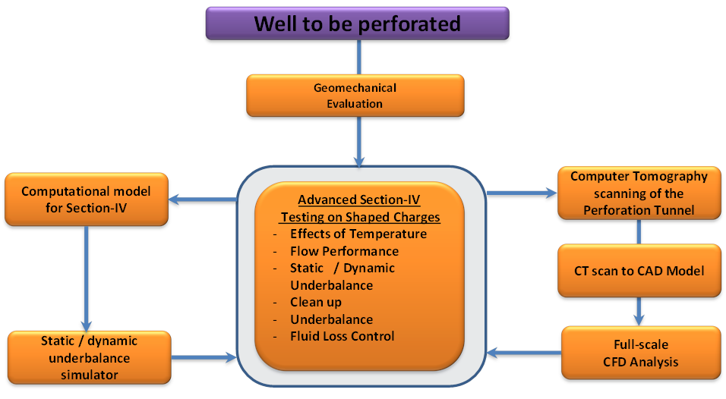
Our Design Philosophy
IPS –15-5
Presented in IPS –15-19
Notes:
We recently developed an engineering workflow that combines experimental and numerical modeling to evaluate and optimize the shaped charge performance. The workflow is primarily targeted towards exploiting the capabilities of a perforation flow laboratory in conjunction with numerical modeling. As seen from the workflow below, apart from the experimental testing in the flow laboratory, our modeling efforts are focused on two aspects:
Development of a novel full-physics CFD model that utilizes digital rock physics to simulate the flow around the true geometry of the perforation tunnel.
Development of a fast computational model based on laboratory apparatus to complement the transient effects seen in lab experiments (focus of this work)

Slide 9
Fast Physics: Model Development
IPS –15-5
We used four major development steps to create this simulation tool :
Conceptual
Simple shape of the pressure transients hint at two dominant physical processes
Test of time scales as rough estimators.
Full Numerical
Develop full models for gun, wellbore, and reservoir.
Implement them in a bench-top environment.
Fast Physics
Use full numerical simulation to understand dominant processes.
Recast full model into simplified “dominant physics” model.
Proof of Concept
Comparison of measured pressure transients with computed values.
Notes:
We used four major development steps to create this simulation tool

Slide 10
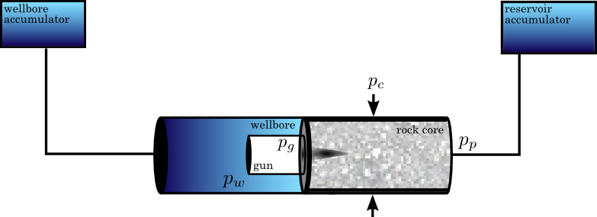
Fast-Physics: Model Components
IPS –15-5
Wellbore
Gun chamber
Rock core
Connectivity to accumulators
Perforation tunnel
Notes:
The schematic above shows the key components of the model (which is similar to the Section-IV apparatus) which include the wellbore, gun chamber, rock core, accumulators and connections and most importantly, the perforation tunnel. Appropriate numerical conditions relating to initial pressures in wellbore, pore, gun chamber are considered. The rock core properties considered include the porosity and permeability.

Slide 11
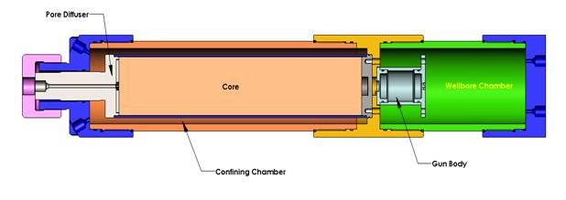
Fast-Physics: Model Assumptions
IPS –15-5
Wellbore
Weakly compressible
Isothermal
Inviscid flow
Gun Chamber
Compressible ideal gas
Gas expansion is adiabatic
Initially at atmospheric pressure
Rock Core
Uniform porous medium
Linear Darcy flow
Weakly compressible liquid (incompressible rock)
Pore pressure greater than wellbore

Slide 12
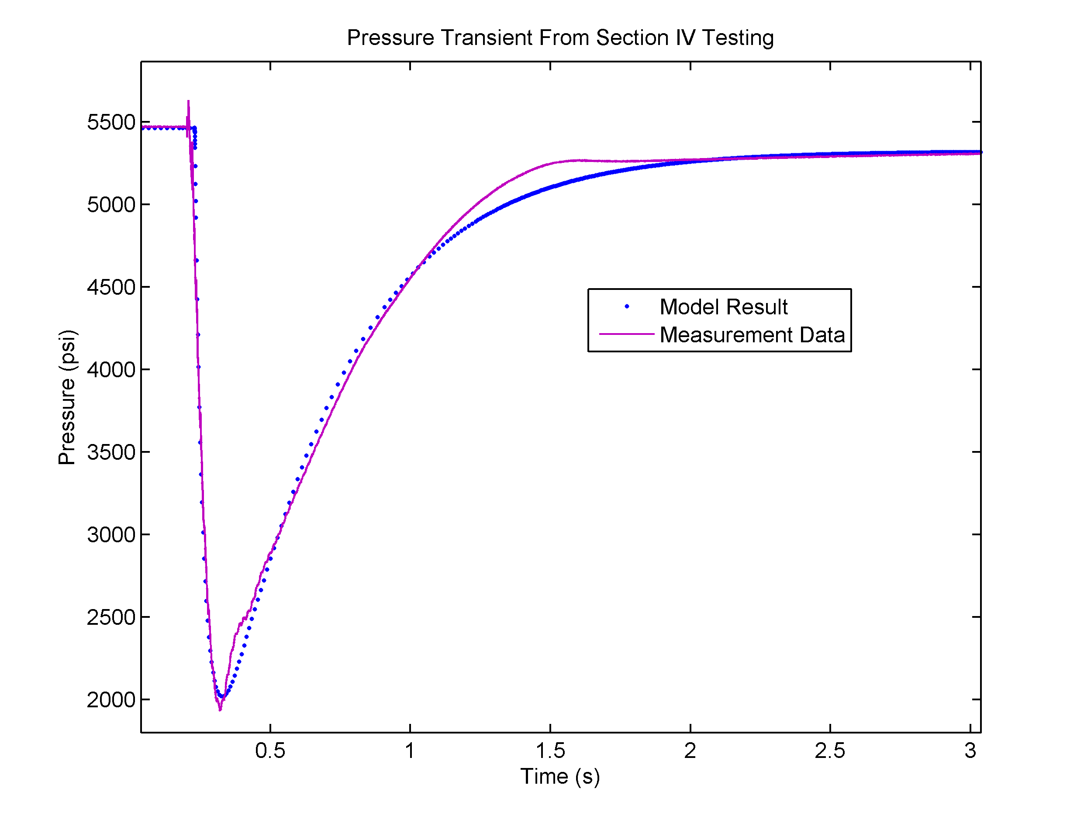
Fast-Physics: Preliminary Results
IPS –15-5
Model fit to measurement data is very good.
No parameter “fudging”, all parameters are physics-based and their values lend insight into the physical flow
Each run takes <100 ms to run → a fitting tool will be simple and feasible
Efficient tool to understand - underbalance conditions - overbalance conditions - influence of damage zones - clean up dynamics

Slide 13
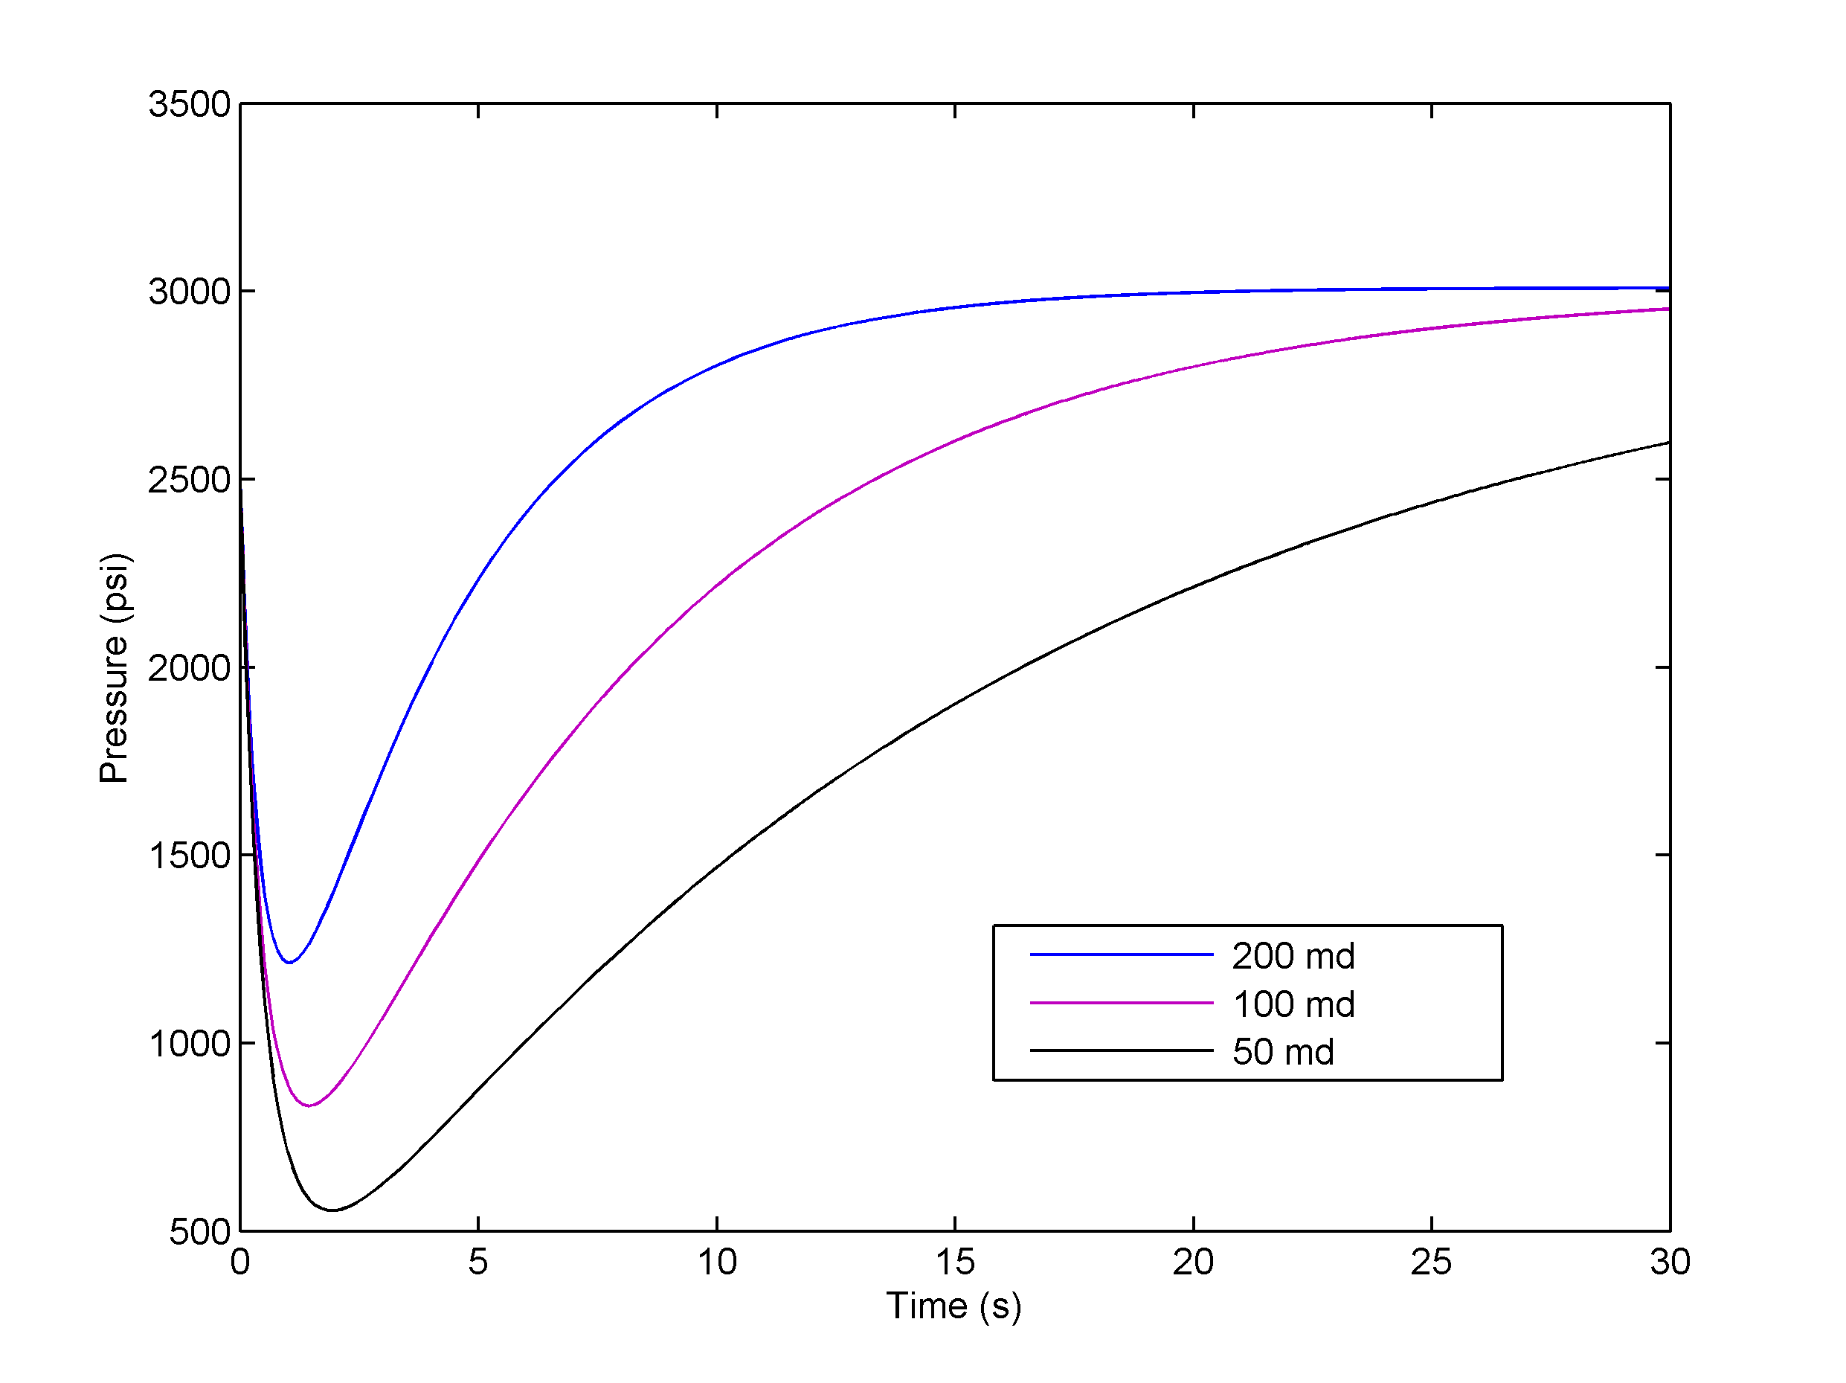
Fast-Physics: Preliminary Parametric Analysis
Gun | Wellbore | Rock Core
geometry (volume) | fluid properties (compressibility) | permeability (volume and non-uniformity)
gas constant | geometry (volume) | Porosity
external conditions | initial state (static underbalance) | Viscosity
shape charge characteristics
An example of modifying permeability
Notes:
The table above again shows the dominant parameters that are used to represent the Section-IV test using a simplified, yet full-physics mathematical model.
The plot shows an example where the model can be quickly used to understand the influence of core permeability on the dynamics of the pressure curve. As expected, as permeability is increased from 50md to 200md,
- the magnitude of dynamic underbalance is reduced
- The time required to reach equilibrium is reduced with increasing permeability

Slide 14
Fast-Physics: Future Plans
Preliminary fast-physics model
Fundamental investigation of perforation dynamics: CFD
Model perforation tunnel geometry
Model damage zones
Burn models
CFD models: crushed zone, exact tunnel geometries
Detailed validation using gauge/CFD data
Integrate clean-up model with fast-physics
Upscale results to existing
field-scale simulator
Notes:
As for the roadmap going forward, the following are the key steps involved:
Current status: First-gen fast physics model to simulate transient dynamics of a Section-IV test has been developed
Improve the model by including perforation geometry effects, crushed zones and more importantly, relevant burn models
Comprehensive validation of the model using gauge data and CFD
Couple BHI’s proprietary clean-up model with fast physics to provide complete insight into underbalance and clean-up predictions
Upscale the fully validated results from fast physics model to field scale simulator since both of them share the same benchtop platform (similar fundamental physics)
It should also be noted that in order to complement and support the development of the fast physics model, we plan to leverage CFD tools. CFD will be used to investigate fundamental mechanisms of perforation dynamics, validations and other critical predictive correlations (influence crushed zone and exact tunnel shape and size). As an example, the animation above shows how we are taking a fundamental approach in understanding perf dynamics. A basic nozzle flow is considered with water at the inlet and quiescent air filled in the channel. The animation (two phase flow) shows how pressure gradients drive the water column and compress the air in the closed channel system. We intend to use these numerical methods to develop a wellbore-gun-core model using CFD where the fluid dynamics is primarily driven by pressure gradients in a two-phase flow system. It should be noted that CFD will be used for subsequent validation of our fast-physics model. Although CFD is a valuable tool, expensive run times are a constraint in fully deploying CFD for dynamic perf studies.

Slide 15
Conclusions
A new model and simulation tool has been developed for interpretation of the pressure transients of an API-RP 19B Section IV flow test.
Model is based on simplified dominant physics
Each simulation runs in < 1 second
Its simple form enables interpretation based directly on physical parameters.
Preliminary results show good agreement between measured high-speed data and computed dynamic pressure data.
As part of our future plans, we are working on
Extending the fast-physics to include details effects of perforation
tunnel characteristics (true size/shape and crushed zone)
Comprehensive validation using gauge and CFD data
Incorporate clean-up and upscaling models

Slide 16
Slide 16
IPS – 15 - 5
Acknowledgements / Thank You
Committee of the 2015 IPS Europe

Slide 17
Slide 17
IPS – 15 - 5
Questions ?

